Slide 1

Tamil Nadu Assembly Election EDA & Prediction
Author is licensed under CC BY
Creator:Karthik R
Election App Weblink:https://pythonhrraulqvcel4auccwnzp8d.streamlit.app/
Project Sourcecode:https://github.com/Karthik6622/PYTHON/tree/main/streamlit/Streamlit_programs/PROJECTS2

Slide 2

Introduction
The "Tamil Nadu Assembly Election EDA & Prediction" project aims to analyze historical data related to Tamil Nadu assembly elections and build predictive models for upcoming elections. Through this project, we seek to gain insights into voting patterns, understand the impact of various factors on election outcomes, and ultimately predict the results of future elections.

Slide 3

Objectives
Exploratory Data Analysis (EDA)
Conduct a thorough analysis of historical data, exploring trends, patterns, and relationships among different variables related to Tamil Nadu assembly elections.
Feature Engineering
Identify key features that significantly influence election outcomes and create relevant variables for predictive modeling.

Slide 4
Objectives
Predictive Modeling
Develop machine learning models to predict election results based on historical data. Evaluate and fine-tune models for accuracy and reliability.
Visualization
Create interactive visualizations to present key findings, trends, and predictions to stakeholders and the general public.
Stakeholder Engagement
Engage with stakeholders, political analysts, and the public to discuss and validate the insights derived from the analysis and predictions.

Slide 5

Methodology
Data Collection
Gather comprehensive data sets on Tamil Nadu assembly elections, including information on constituencies, candidates, voter demographics, and election results.
Data Cleaning and Preprocessing
Cleanse the data, handle missing values, and preprocess it for analysis. Ensure data quality and consistency.

Slide 6
Methodology
Exploratory Data Analysis
Perform in-depth exploratory data analysis to uncover patterns, correlations, and trends within the data. Use statistical and visual analysis techniques.
Feature Engineering
Identify and create relevant features that contribute to the predictive power of the models.

Slide 7
Methodology
Machine Learning Models
Employ machine learning algorithms, such as Random Forest, Logistic Regression, or others, to predict election outcomes based on historical data.
Evaluation and Fine-Tuning
Evaluate model performance, fine-tune parameters, and validate predictions using historical election results.

Slide 8

Deliverables
Interactive Data Visualizations
Share interactive visualizations showcasing key insights and trends derived from the EDA.
Predictive Models
Provide well-documented machine learning models for predicting election outcomes.

Slide 9
Deliverables
Stakeholder Reports
Generate reports summarizing the findings, insights, and predictions, suitable for stakeholders and the general public.
Public Engagement
Conduct presentations and engage with the public through online platforms to share insights and predictions, fostering a data-driven understanding of elections.

Slide 10

Conclusion
The "Tamil Nadu Assembly Election EDA & Prediction" project aims to provide valuable insights into the dynamics of Tamil Nadu assembly elections. Through a combination of exploratory data analysis, predictive modeling, and stakeholder engagement, we aim to contribute to a better understanding of electoral processes and outcomes.

Slide 11
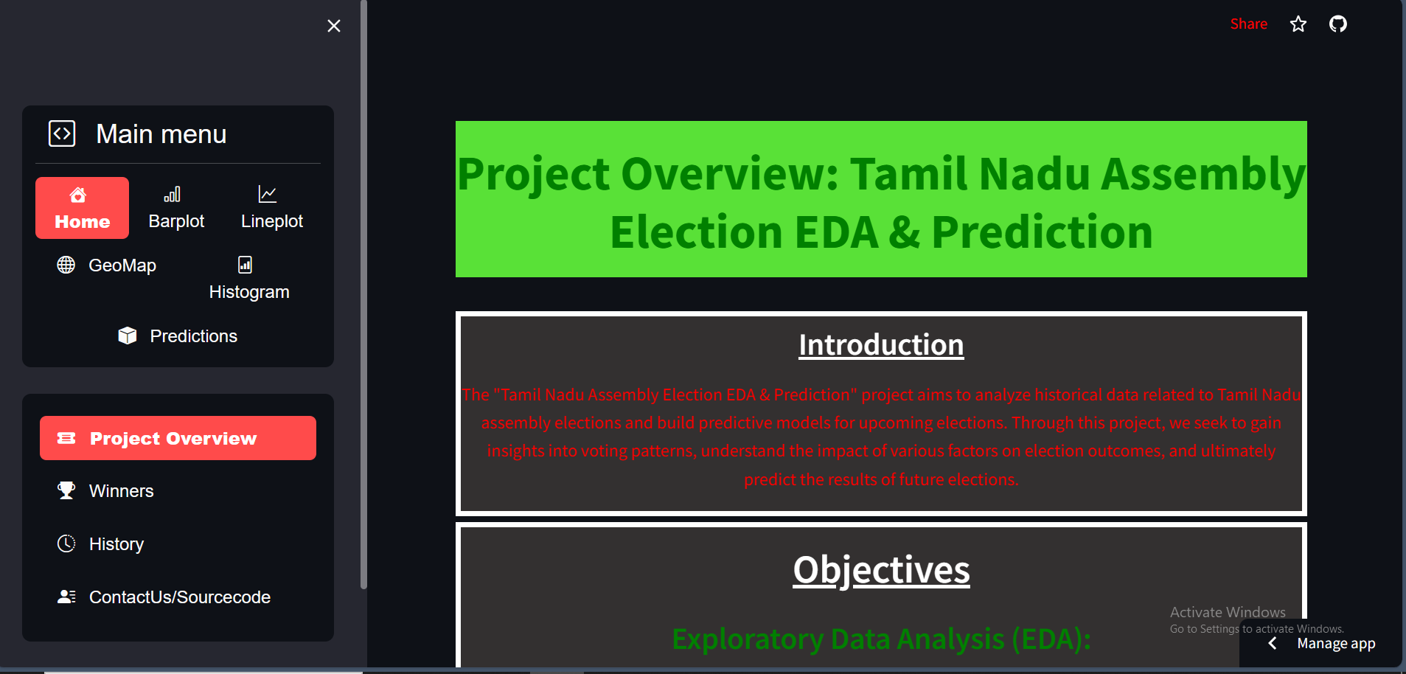
Explanation of Election App (Election App Link:https://pythonhrraulqvcel4auccwnzp8d.streamlit.app/)
Home Page of Tamil Nadu Assembly EDA & Prediction WebApp.
Defaultly it was selected Project Overview
In Project overview Page, we can get it all details of Election Project.
CHEMICAL
NATURAL

Slide 12
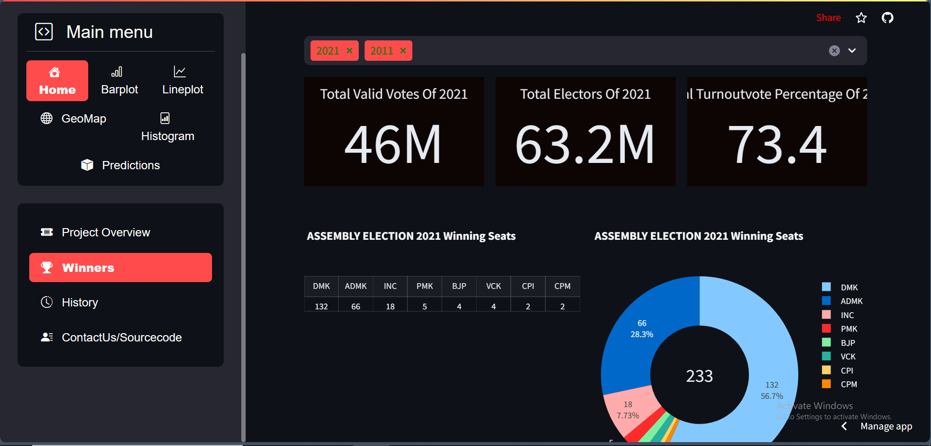
Explanation of Election App (Election App Link:https://pythonhrraulqvcel4auccwnzp8d.streamlit.app/)
HOME→WINNERS
In Winners Page, we can get it know who are the parties win by year wise.
(E.X)In Left Photo We selected 2021 and 2011 winners, so it’s displayed winner parties with their votes like a Table,Tiles,Pie Charts.
CHEMICAL
NATURAL

Slide 13
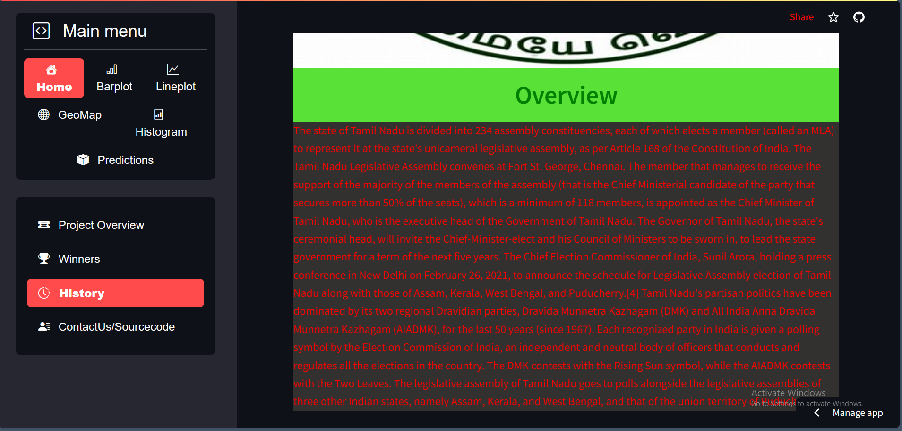
Explanation of Election App (Election App Link:https://pythonhrraulqvcel4auccwnzp8d.streamlit.app/)
HOME→HISTORY
In History Page, We can View the Details of Tamil Elections and Types of elections
CHEMICAL
NATURAL

Slide 14
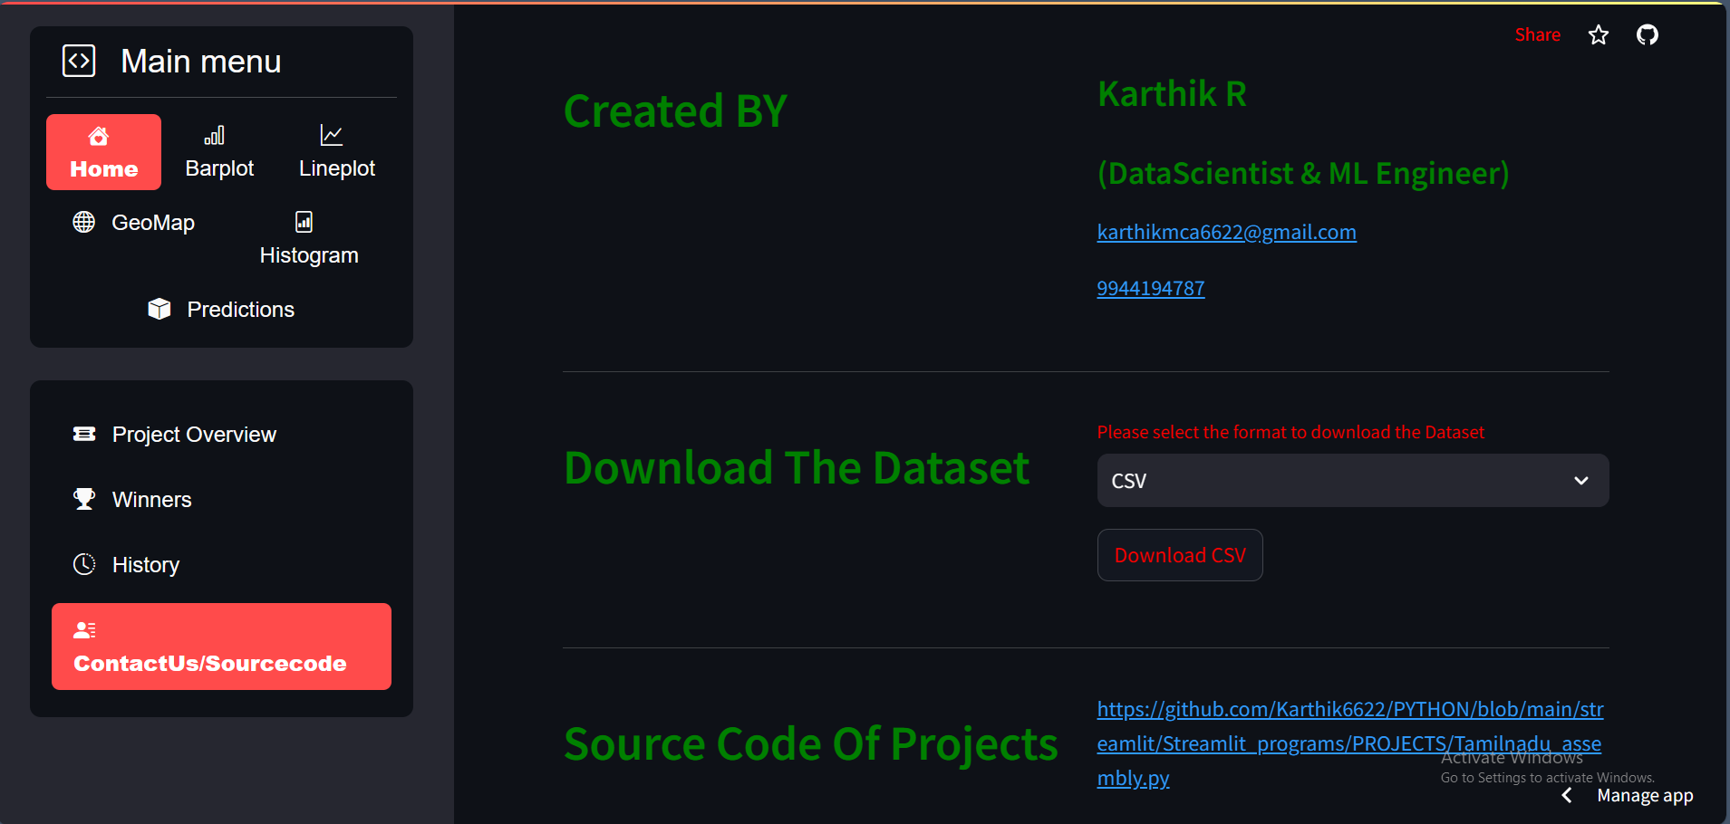
Explanation of Election App (Election App Link:https://pythonhrraulqvcel4auccwnzp8d.streamlit.app/)
HOME→ContactUs/Source code
In Contact Us Page, we can get it know about creator of this project and we can download election dataset as we required format(csv,Excel,Html,Pdf,Txt) and finally we can see the Source code and Source files.
CHEMICAL
NATURAL

Slide 15
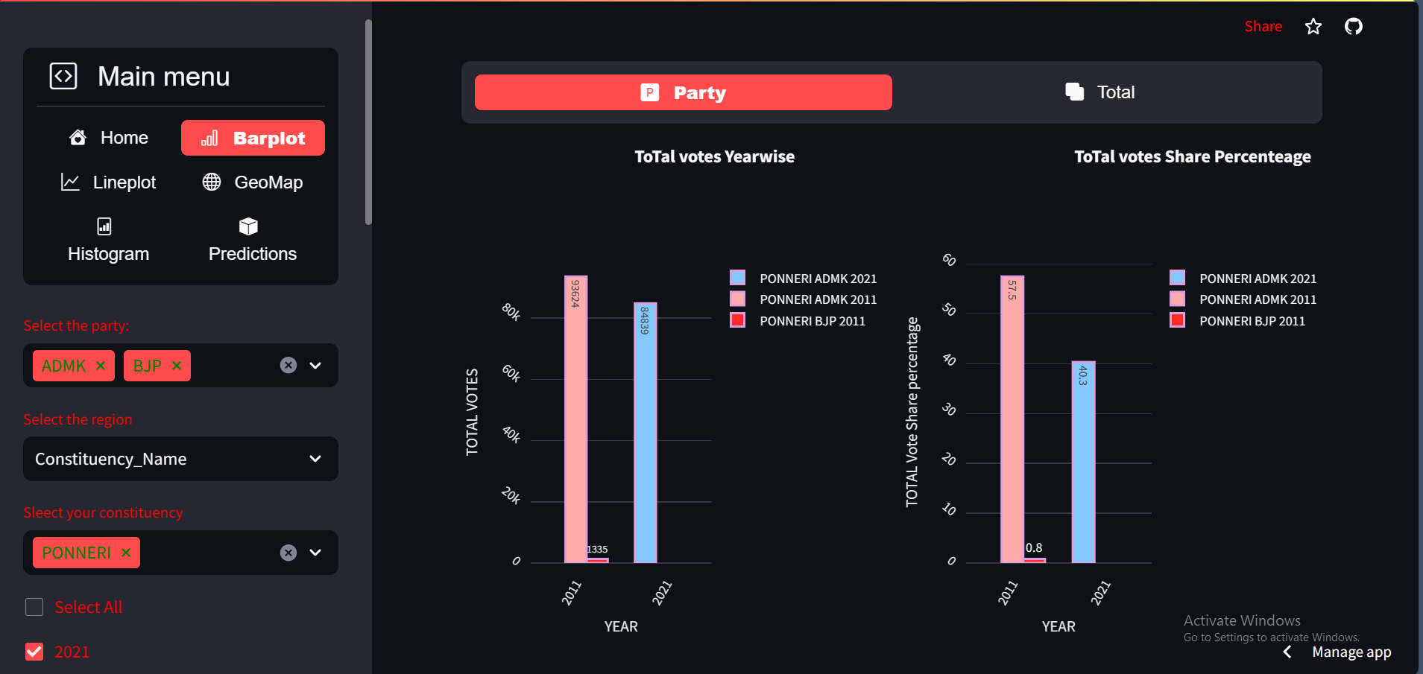
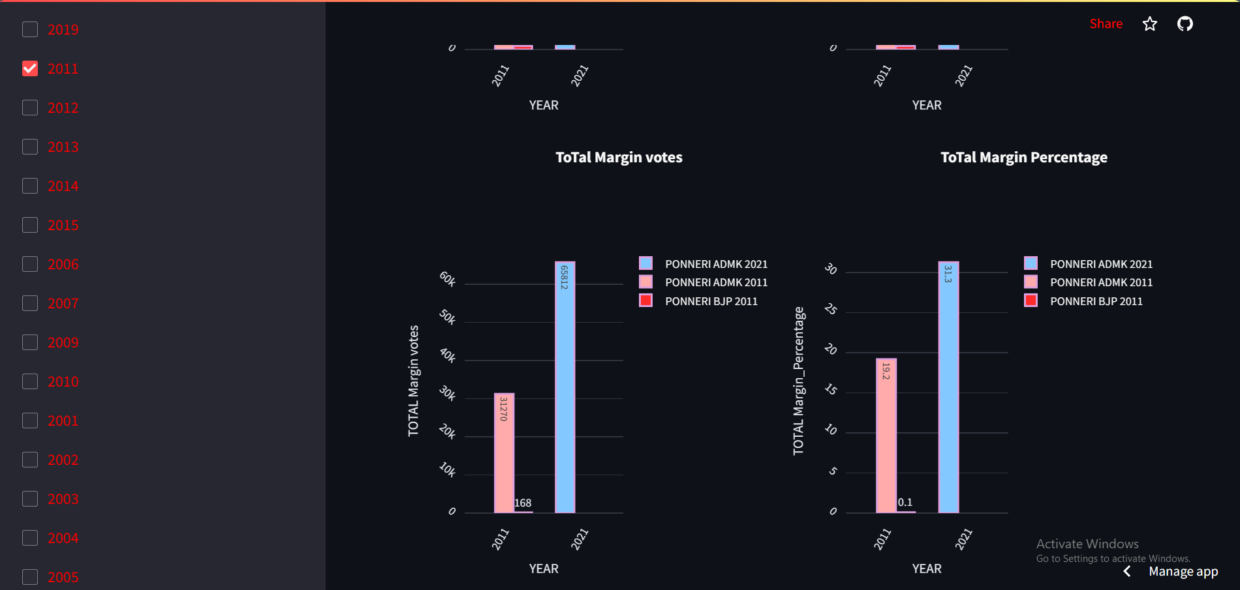


Explanation of Election App (Election App Link:https://pythonhrraulqvcel4auccwnzp8d.streamlit.app/)
BARPLOT→PARTY
Here, We can see the partwise bar plot of Total Votes Yearwise,Total votes Share Percentage yearwise,Total Margin Votes year wise and Total MarginPercentage year wise by selecting party,Year and constituency name.
CHEMICAL
NATURAL

Slide 16
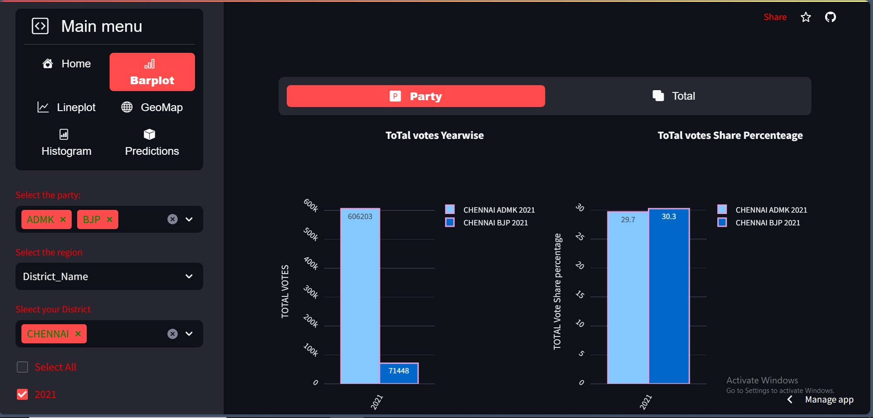
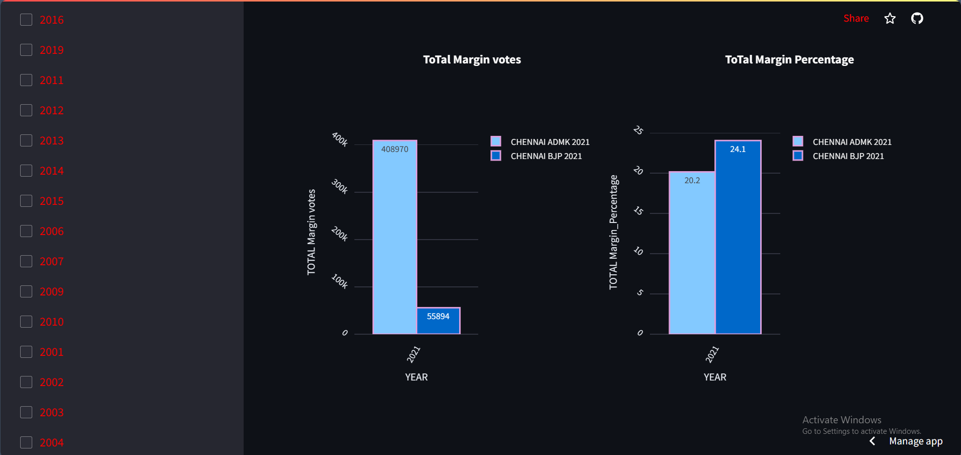

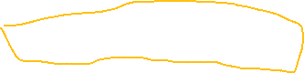
Explanation of Election App (Election App Link:https://pythonhrraulqvcel4auccwnzp8d.streamlit.app/)
BARPLOT→PARTY
Here, We can see the partwise bar plot of Total Votes Yearwise,Total votes Share Percentage yearwise,Total Margin Votes year wise and Total MarginPercentage year wise by selecting party,Year and District name.
CHEMICAL
NATURAL

Slide 17
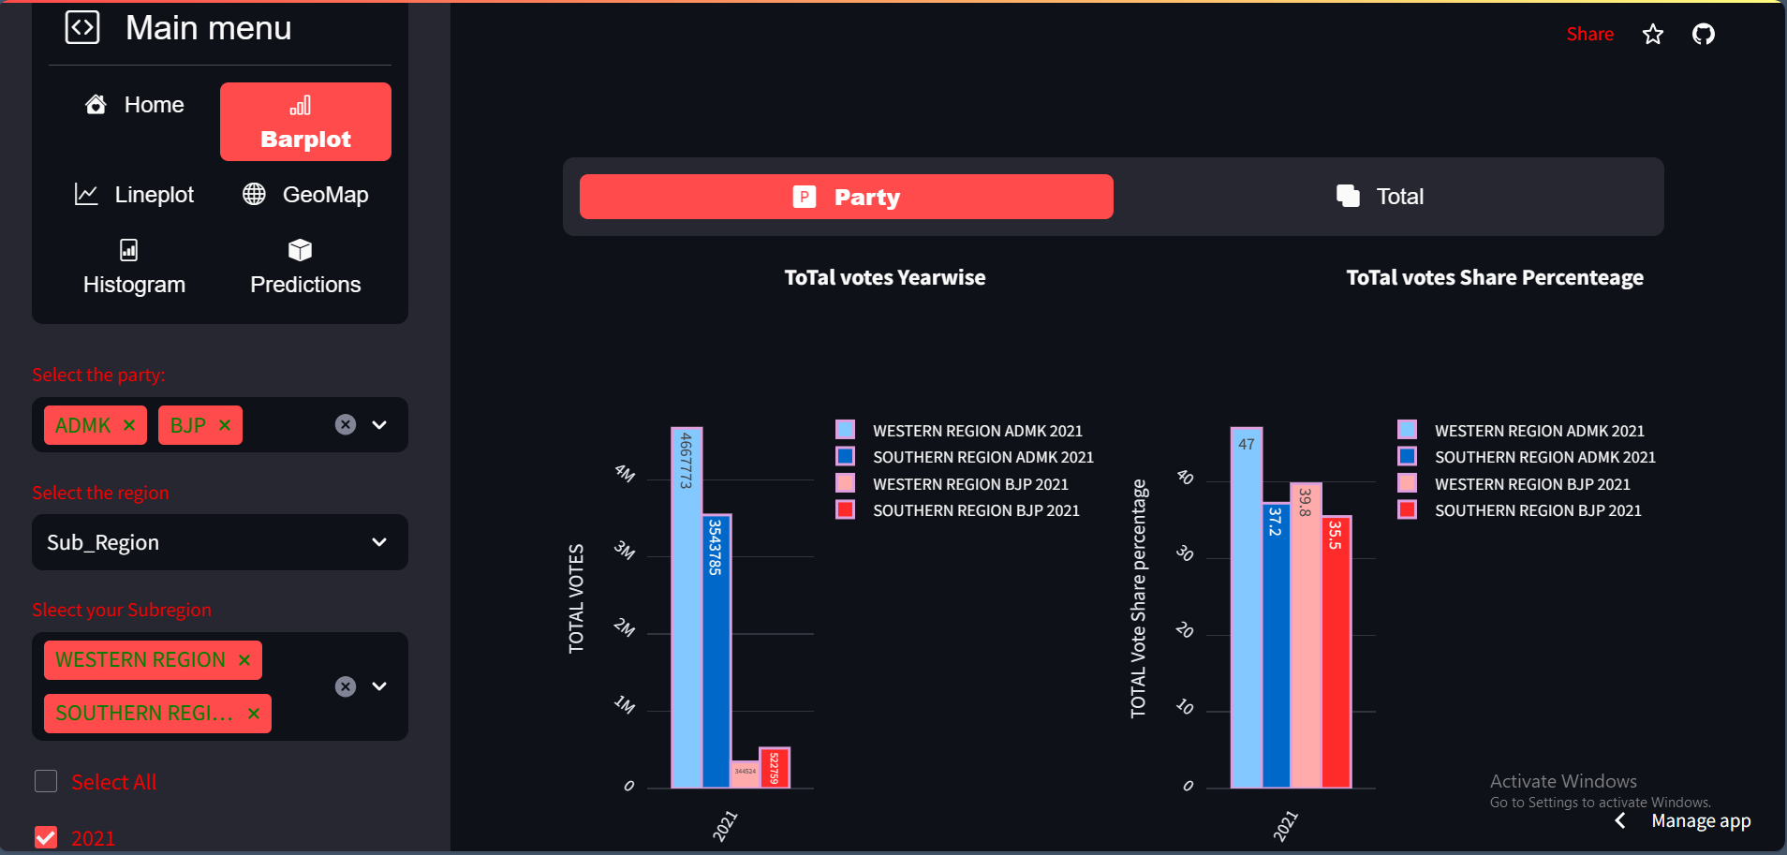
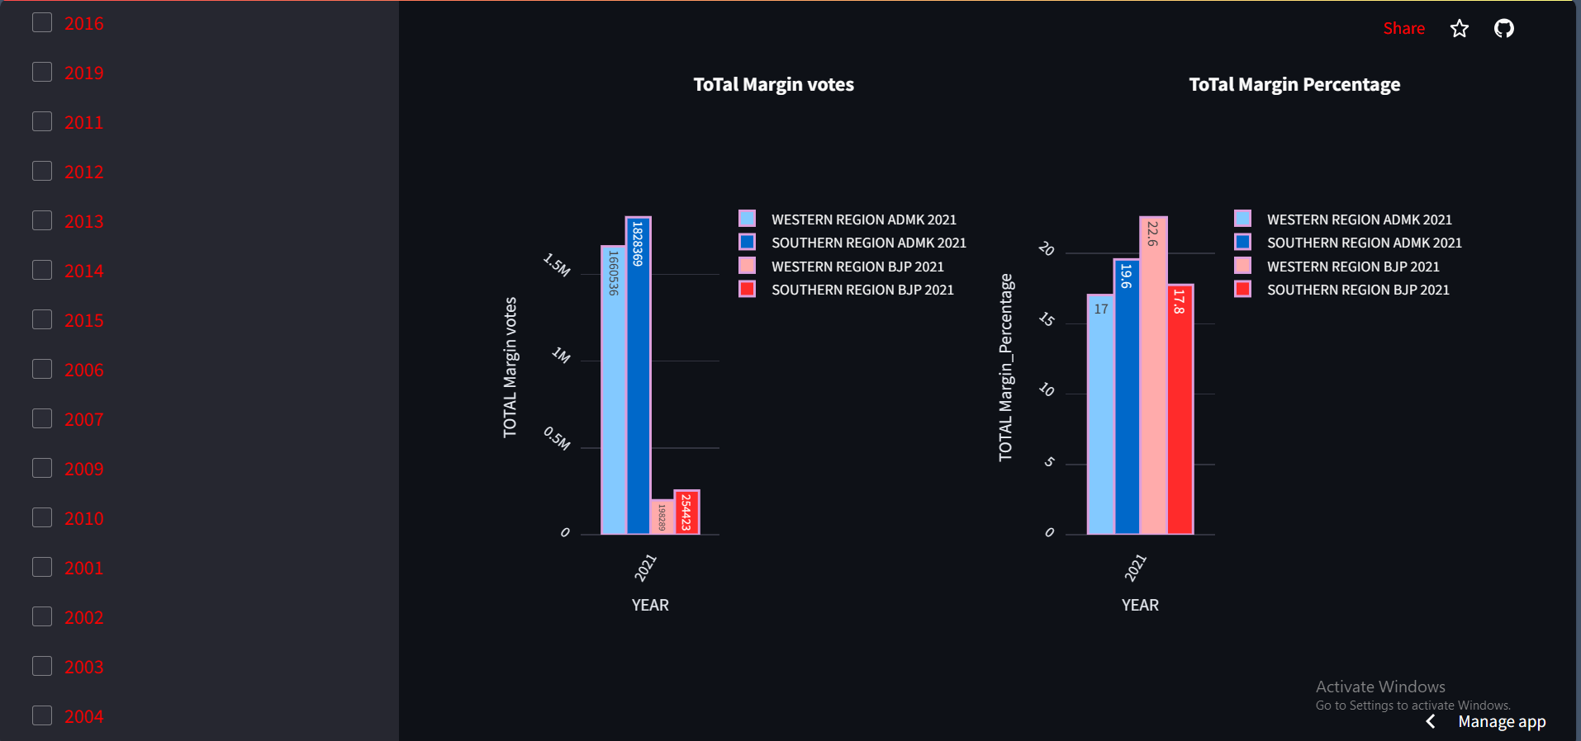


Explanation of Election App (Election App Link:https://pythonhrraulqvcel4auccwnzp8d.streamlit.app/)
BARPLOT→PARTY
Here, We can see the partwise bar plot of Total Votes Yearwise,Total votes Share Percentage yearwise,Total Margin Votes year wise and Total MarginPercentage year wise by selecting party,Year and sub region.
CHEMICAL
NATURAL

Slide 18
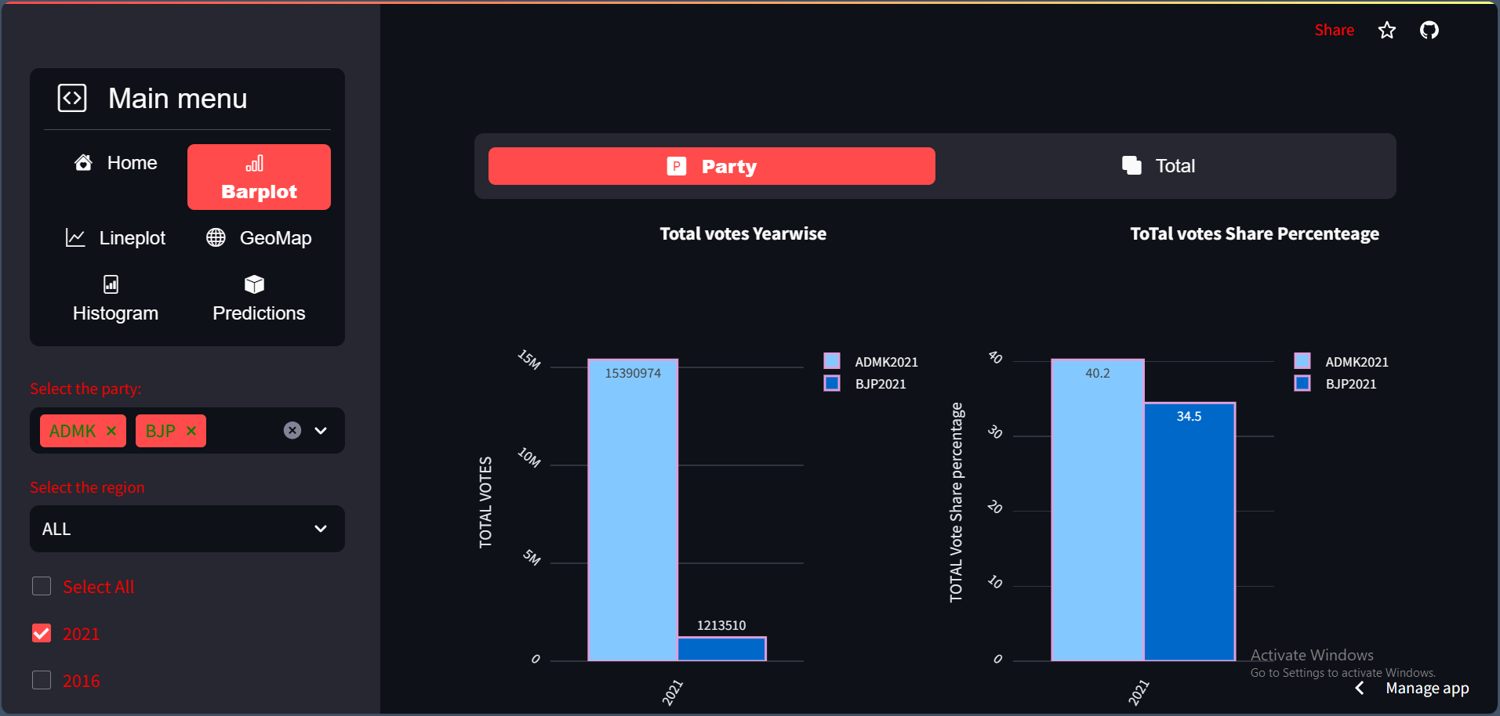
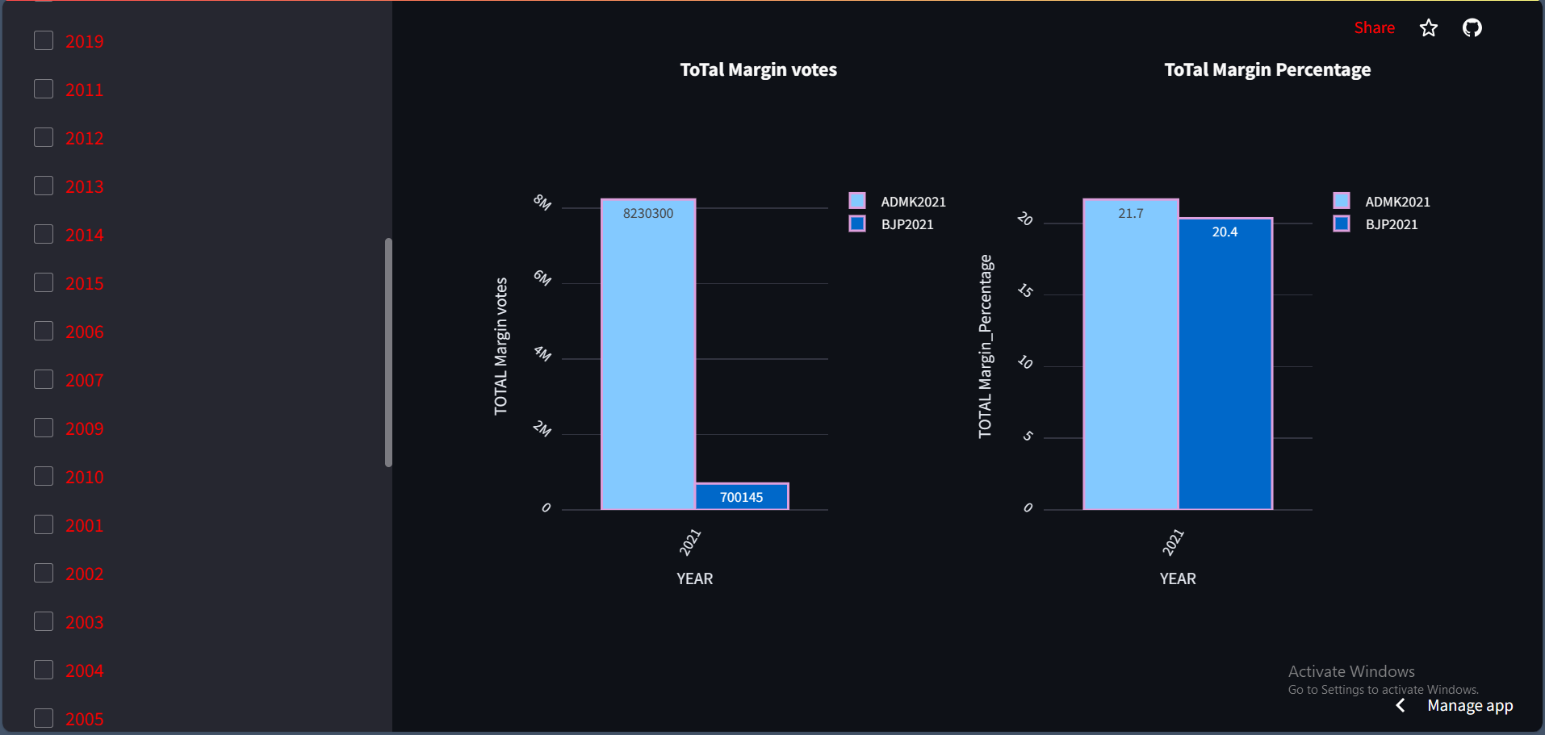

Explanation of Election App (Election App Link:https://pythonhrraulqvcel4auccwnzp8d.streamlit.app/)
BARPLOT→PARTY
Here, We can see the partwise bar plot of Total Votes Yearwise,Total votes Share Percentage yearwise,Total Margin Votes year wise and Total MarginPercentage year wise by selecting party, Year and All(full tamilnadu).
CHEMICAL
NATURAL

Slide 19
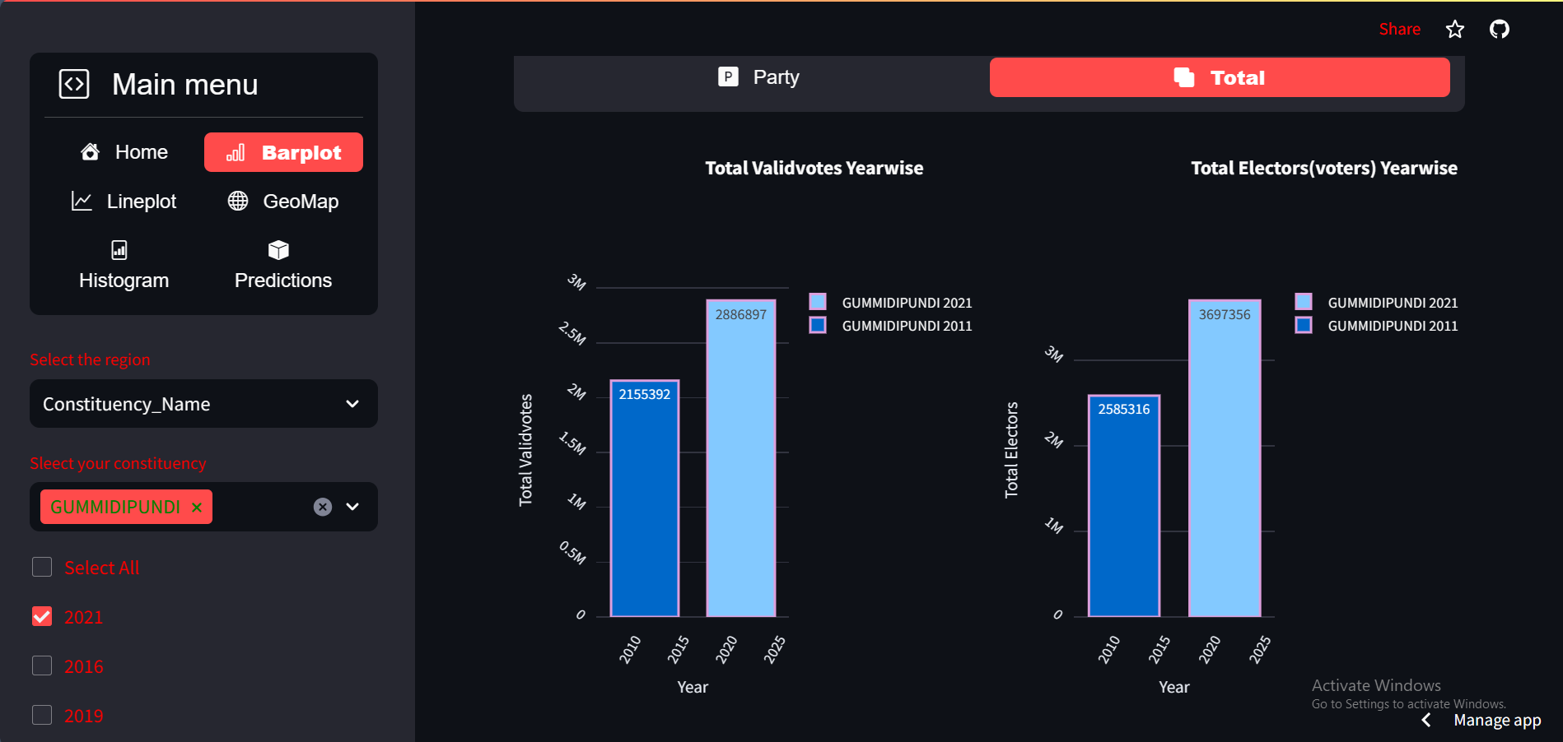
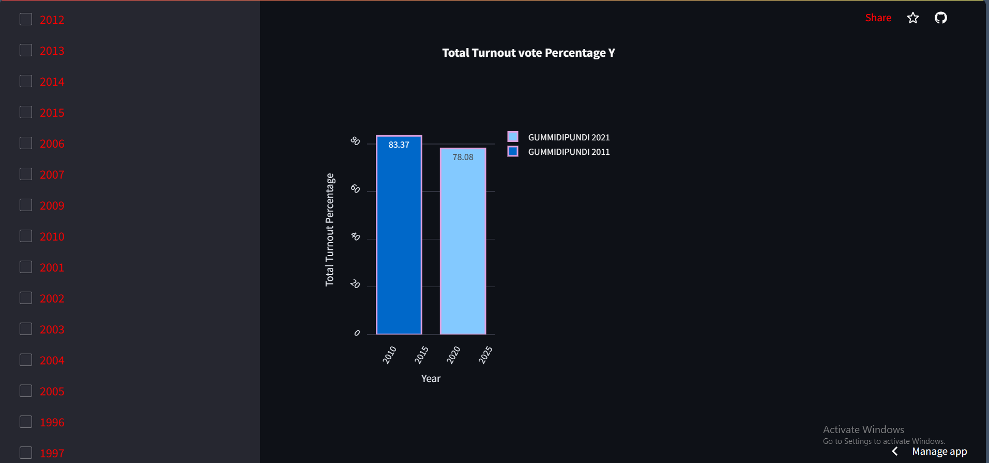


Explanation of Election App (Election App Link:https://pythonhrraulqvcel4auccwnzp8d.streamlit.app/)
BARPLOT→Total
Here, We can see the Total bar plot of Total Valid Votes Yearwise,Total Voters Year wise Total Turnout Vote Percentage year wise by selecting year and Consituency_name.
CHEMICAL
NATURAL

Slide 20
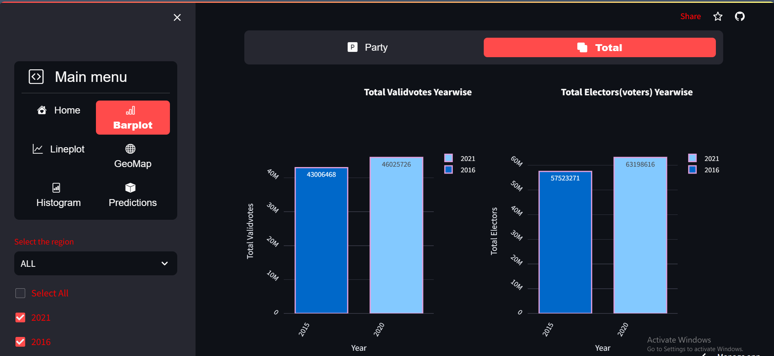
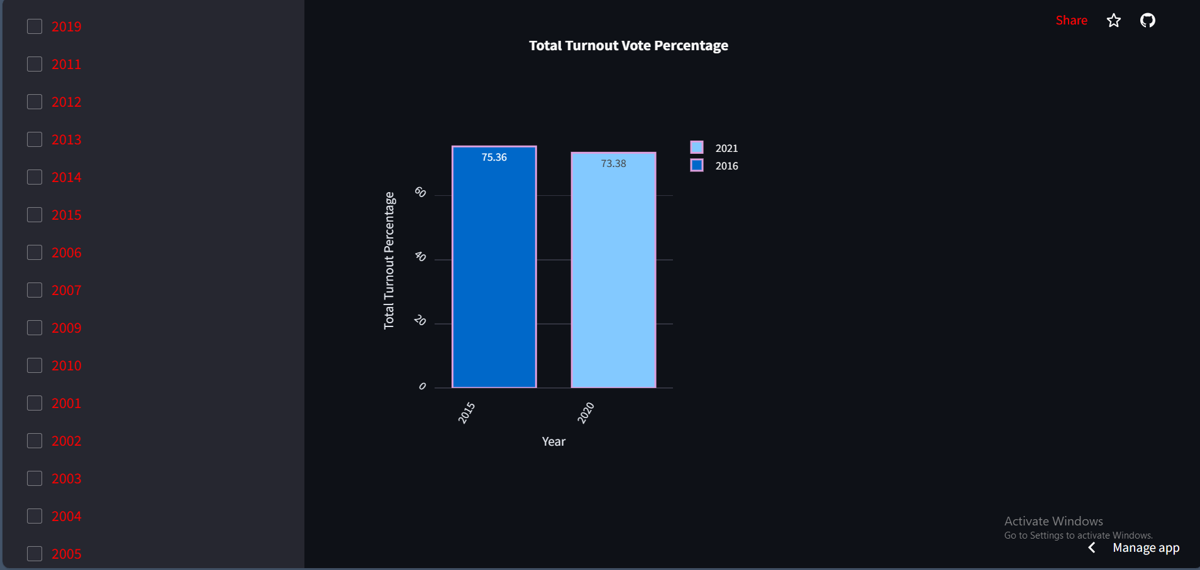


Explanation of Election App (Election App Link:https://pythonhrraulqvcel4auccwnzp8d.streamlit.app/)
BARPLOT→Total
Here, We can see the Total bar plot of Total Valid Votes Yearwise,Total Voters Year wise Total Turnout Vote Percentage year wise by selecting year and All(full tamilnadu).
CHEMICAL
NATURAL

Slide 21
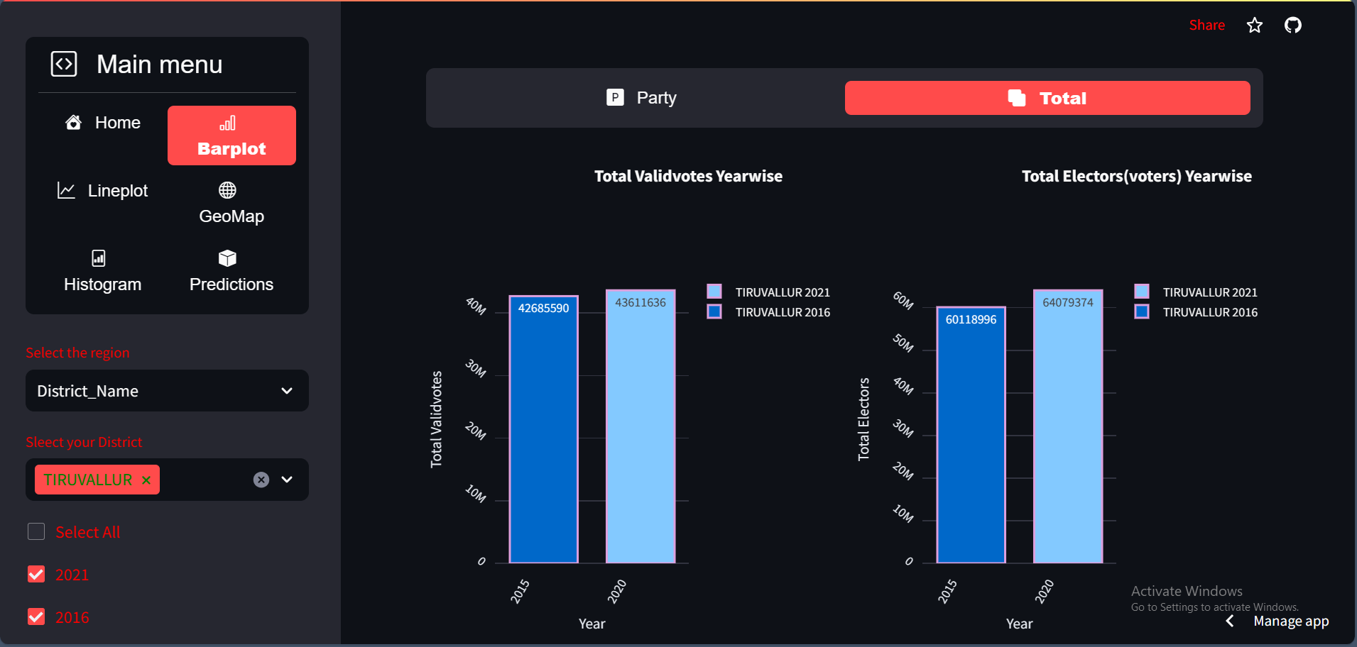
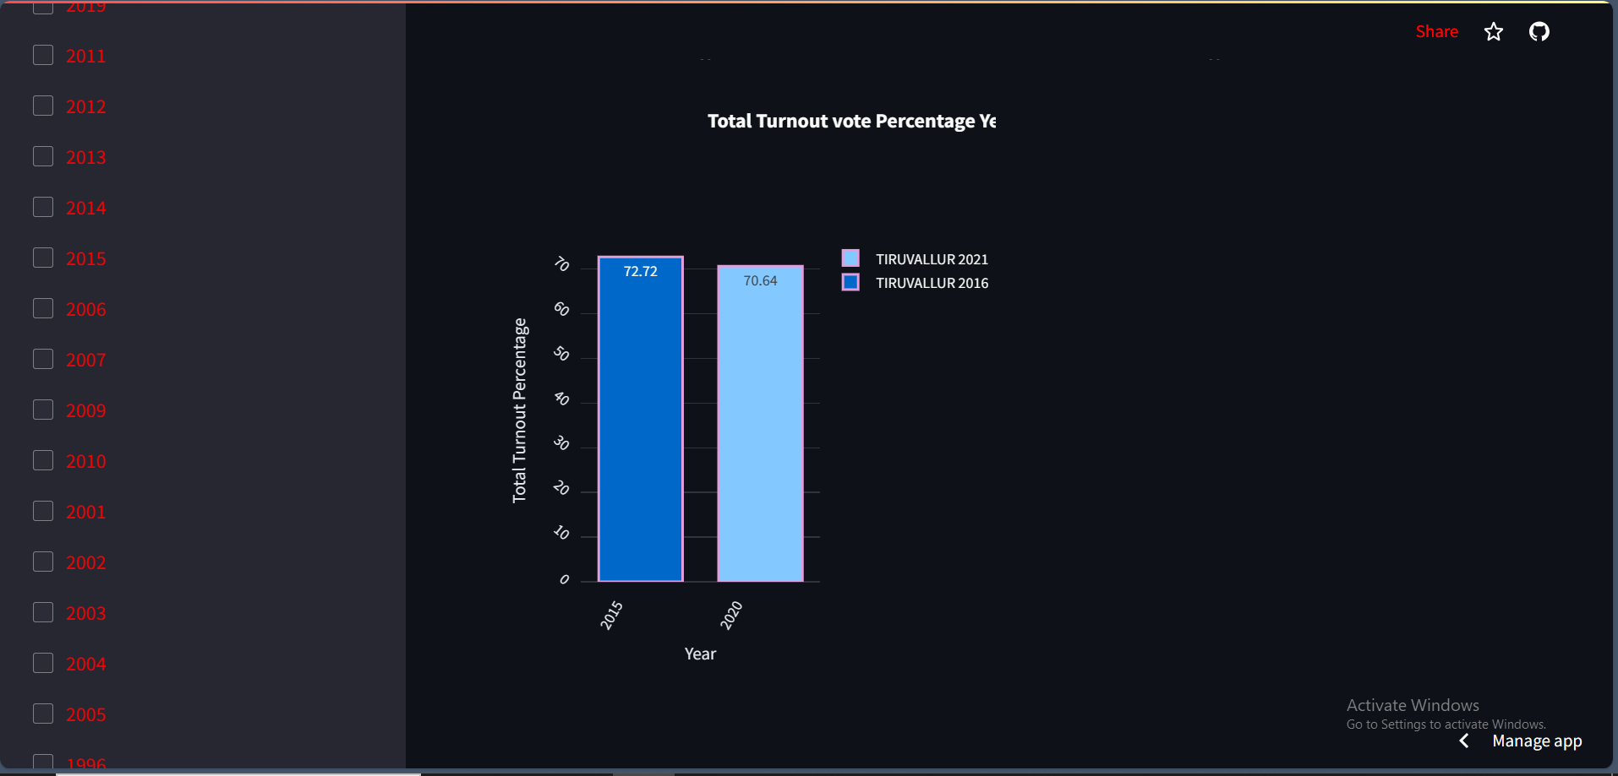

Explanation of Election App (Election App Link:https://pythonhrraulqvcel4auccwnzp8d.streamlit.app/)
BARPLOT→Total
Here, We can see the Total bar plot of Total Valid Votes Yearwise,Total Voters Year wise Total Turnout Vote Percentage year wise by selecting year and District Name(district wise).
CHEMICAL
NATURAL

Slide 22
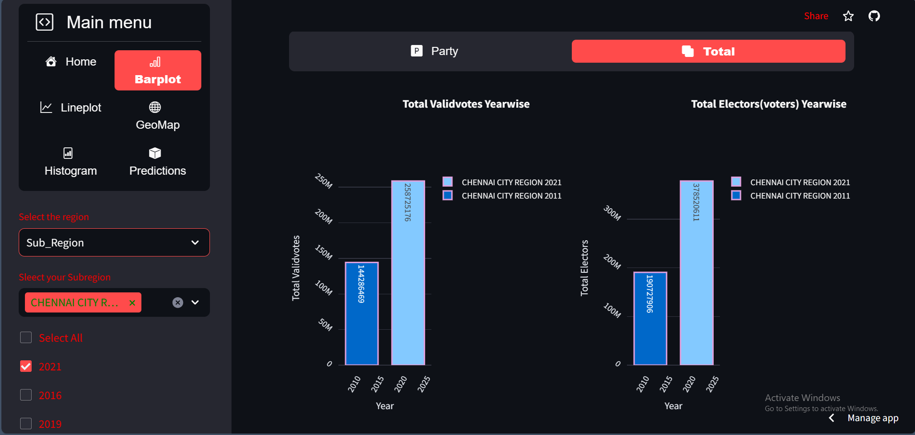
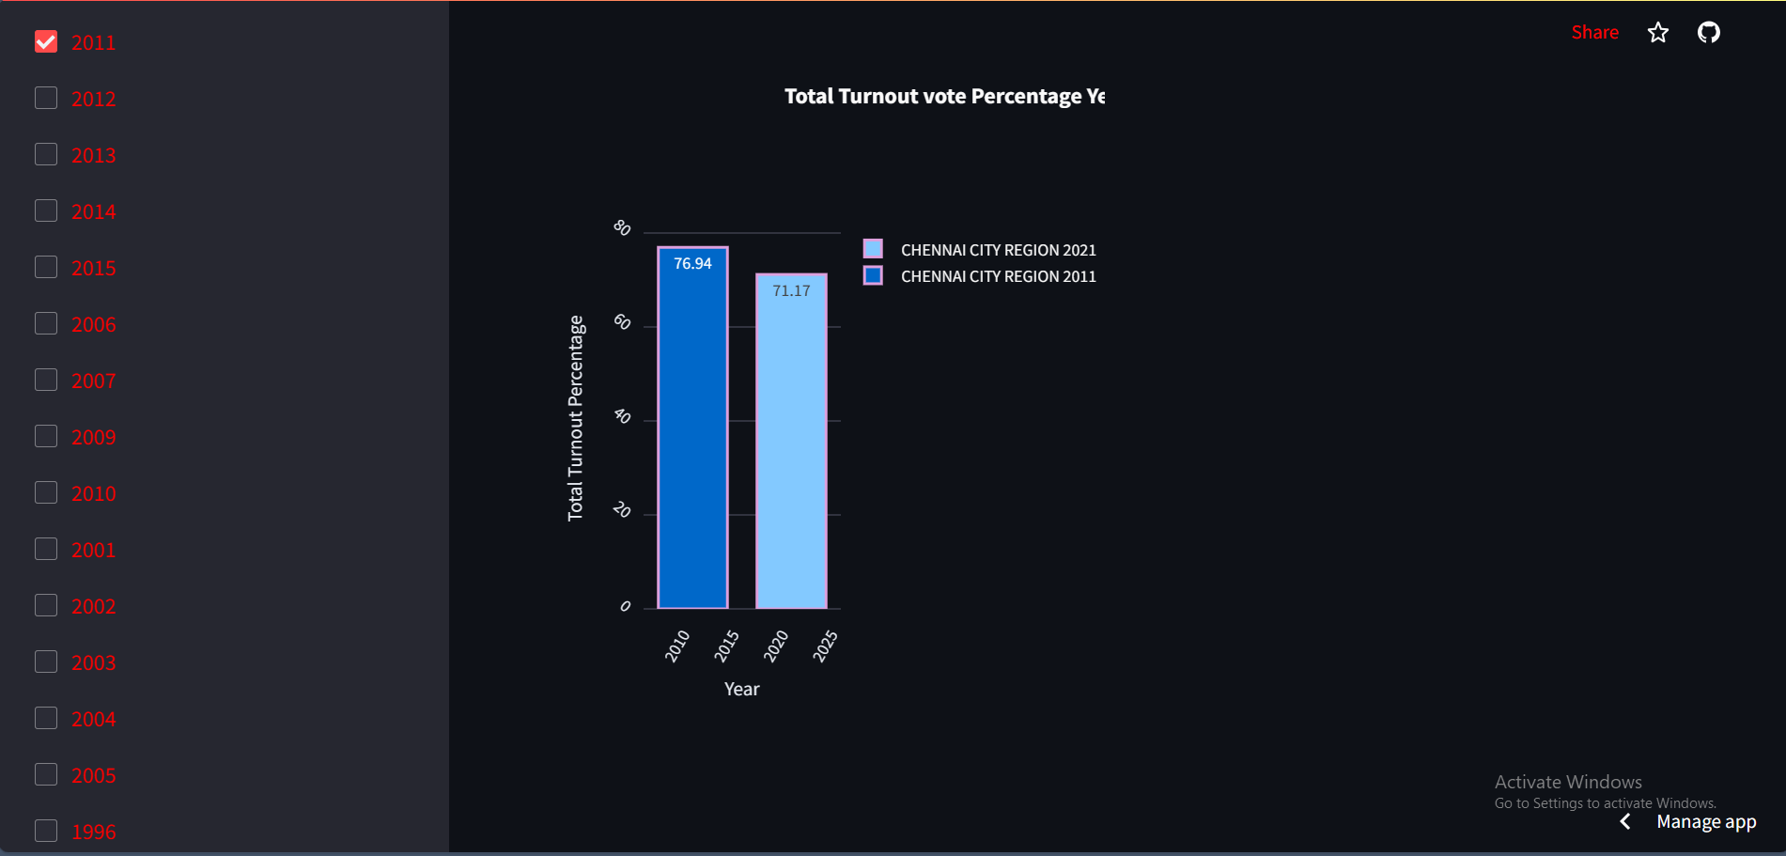

Explanation of Election App (Election App Link:https://pythonhrraulqvcel4auccwnzp8d.streamlit.app/)
BARPLOT→Total
Here, We can see the Total bar plot of Total Valid Votes Yearwise,Total Voters Year wise Total Turnout Vote Percentage year wise by selecting year and Sub_Regions.
CHEMICAL
NATURAL

Slide 23
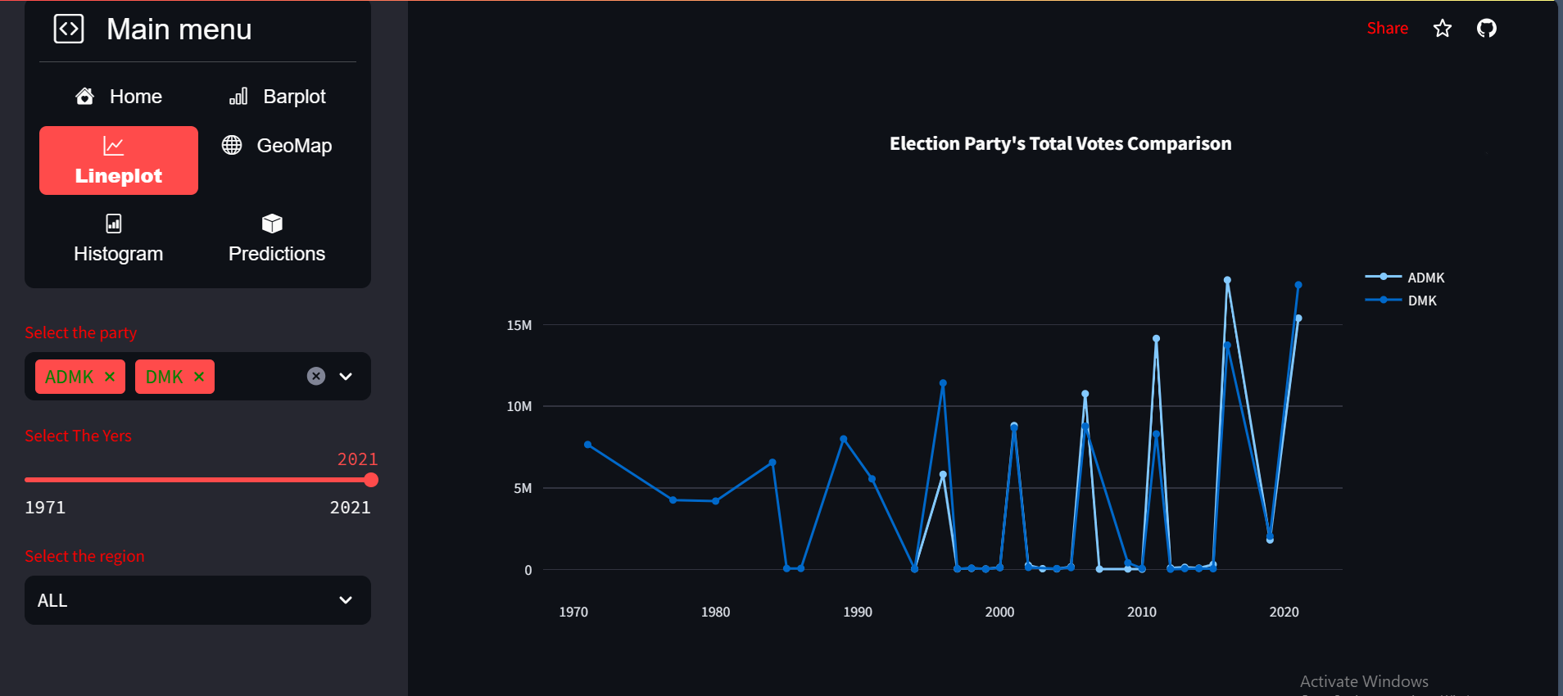
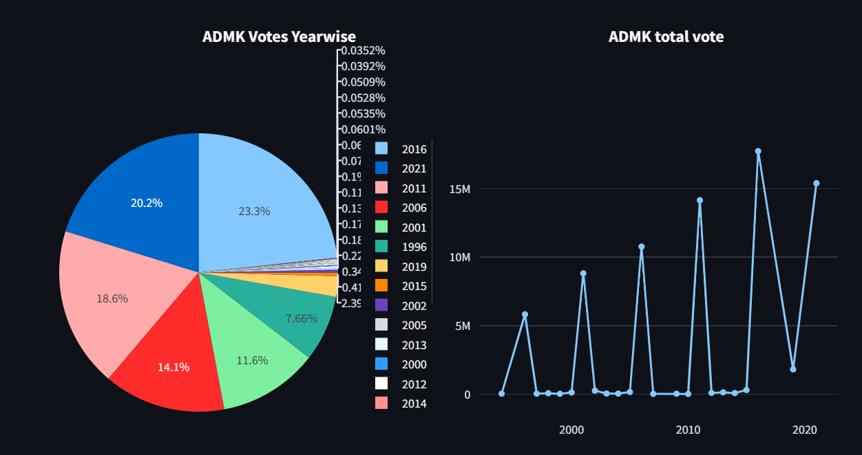
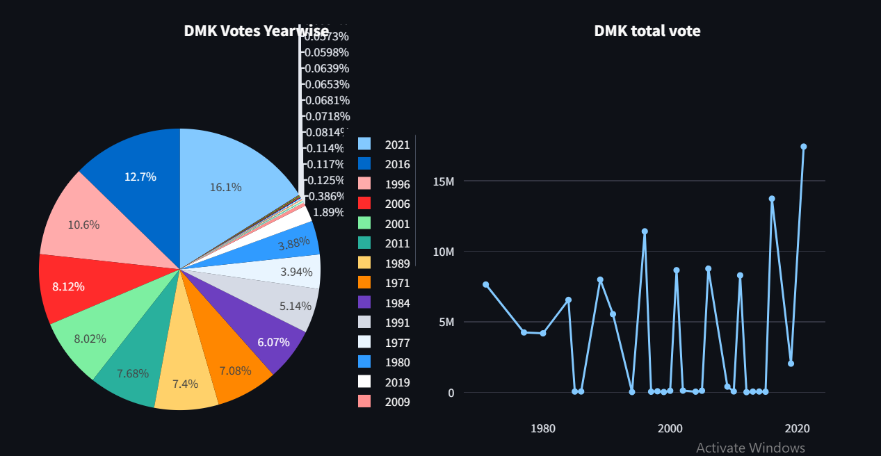

Explanation of Election App (Election App Link:https://pythonhrraulqvcel4auccwnzp8d.streamlit.app/)
LINEPLOT
Here, We can see the party wise line plot of Election party’s Total votes Comparison by selecting Party, year to year and all regions.
It will display total votes line and pie charts for each selected party.
CHEMICAL
NATURAL

Slide 24
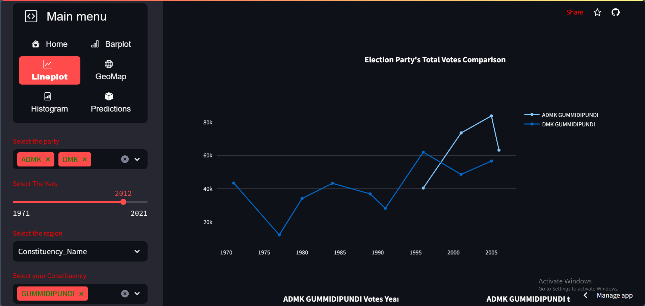
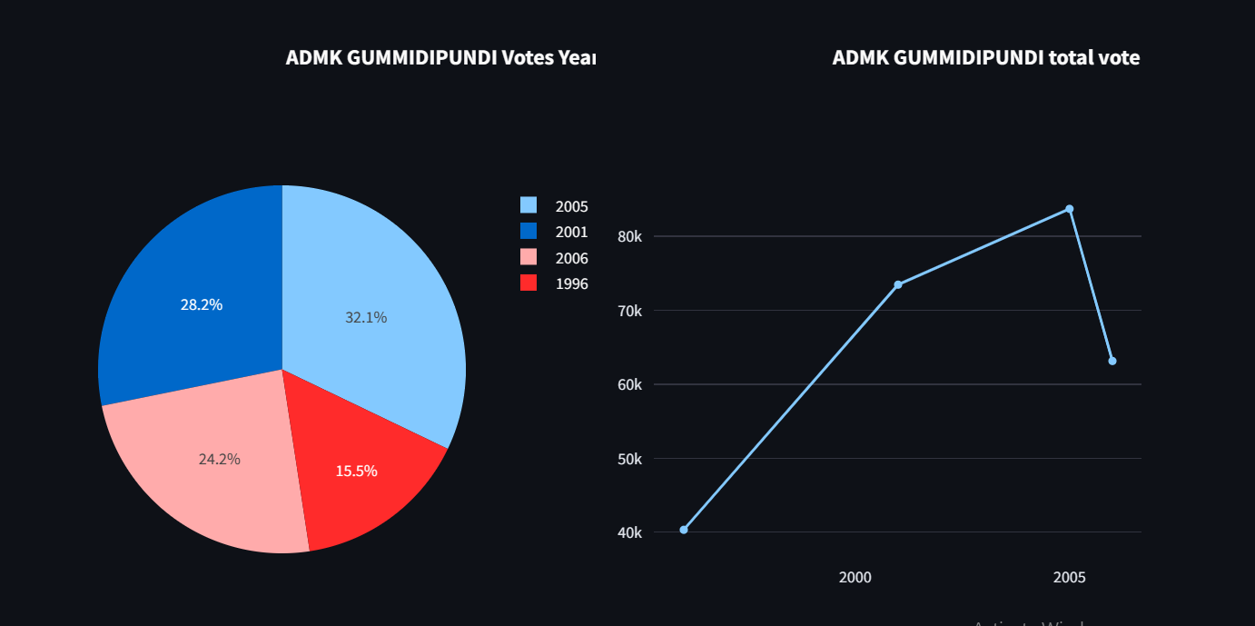
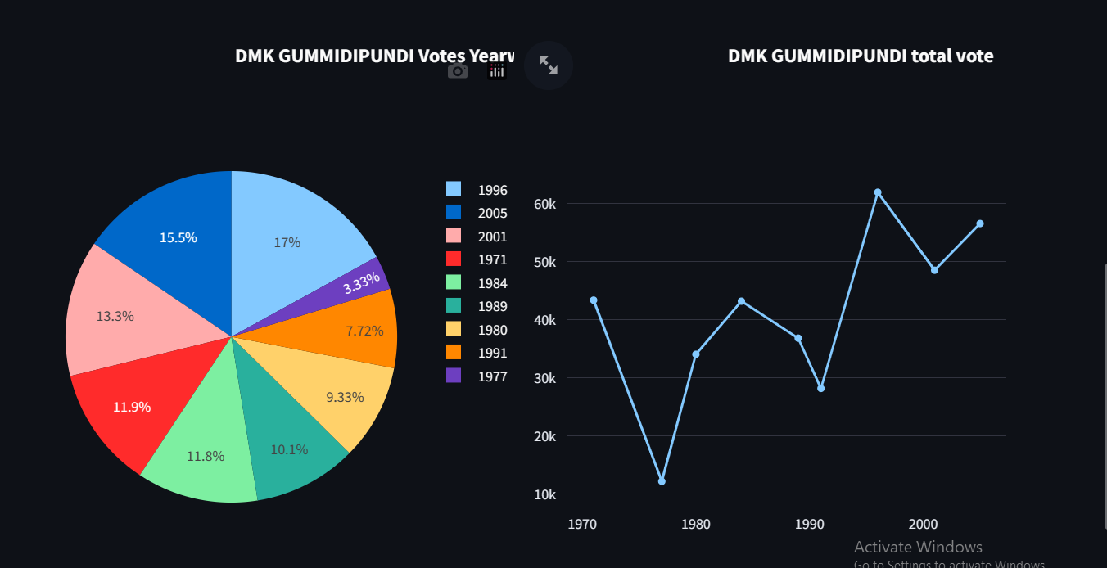

Explanation of Election App (Election App Link:https://pythonhrraulqvcel4auccwnzp8d.streamlit.app/)
LINEPLOT
Here, We can see the party wise line plot of Election party’s Total votes Comparison by selecting Party, year to year and Constituenct_name.
It will display total votes line and pie charts for each selected party.
CHEMICAL
NATURAL

Slide 25
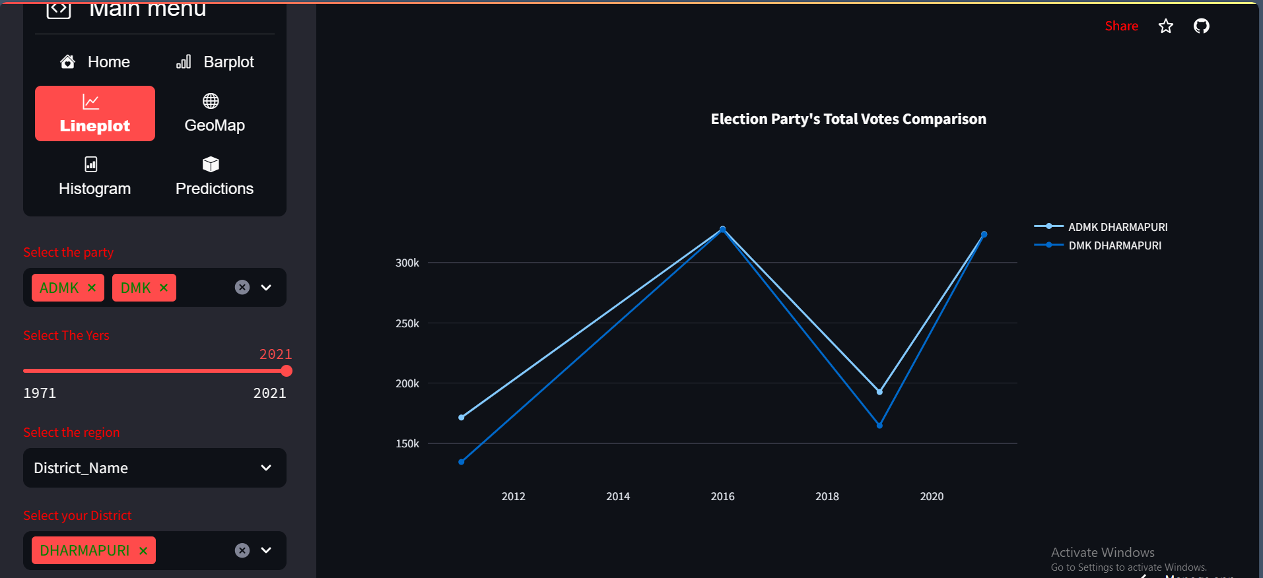
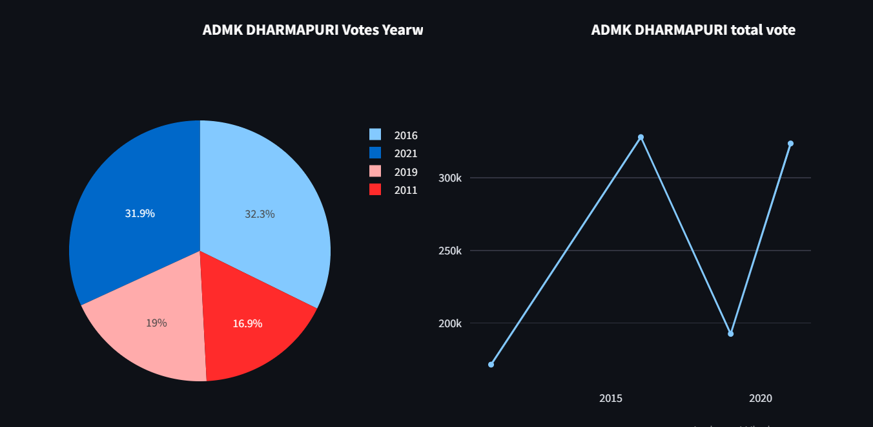
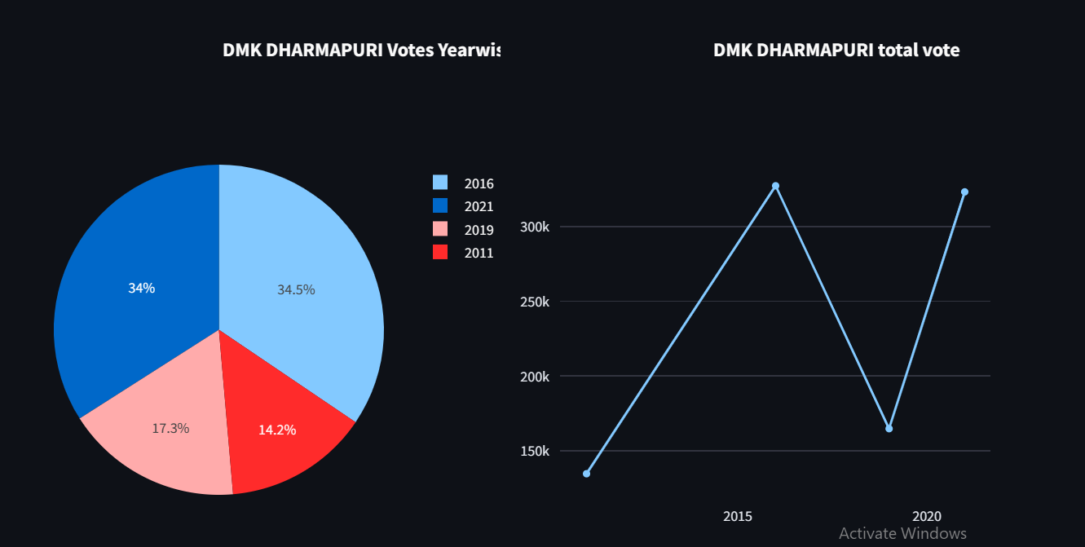

Explanation of Election App (Election App Link:https://pythonhrraulqvcel4auccwnzp8d.streamlit.app/)
LINEPLOT
Here, We can see the party wise line plot of Election party’s Total votes Comparison by selecting Party, year to year and District_name.
It will display total votes line and pie charts for each selected party.
CHEMICAL
NATURAL

Slide 26
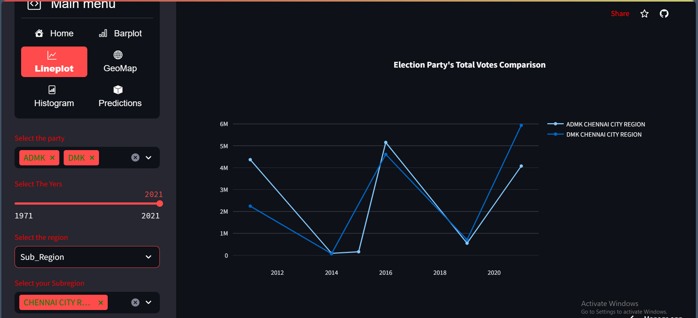
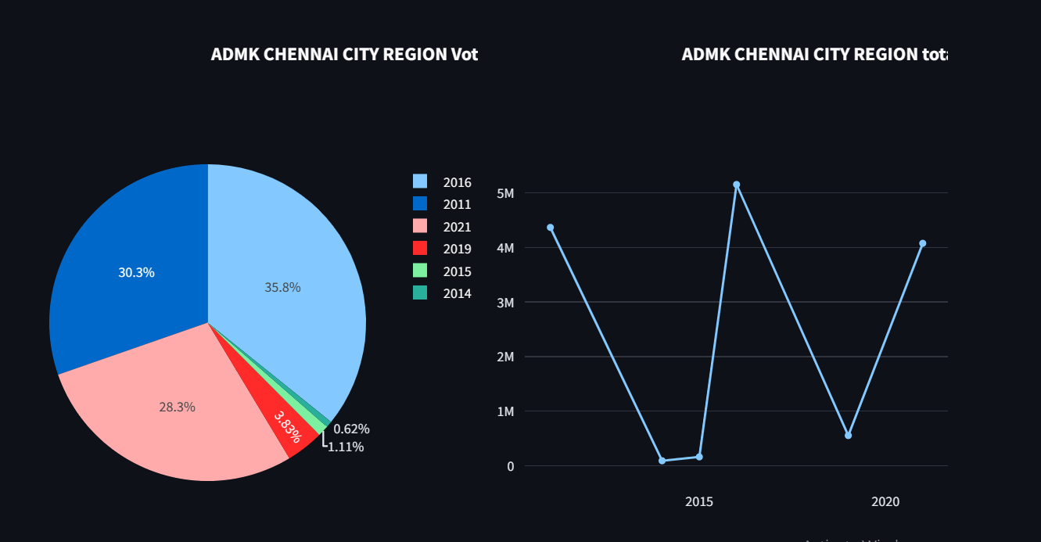
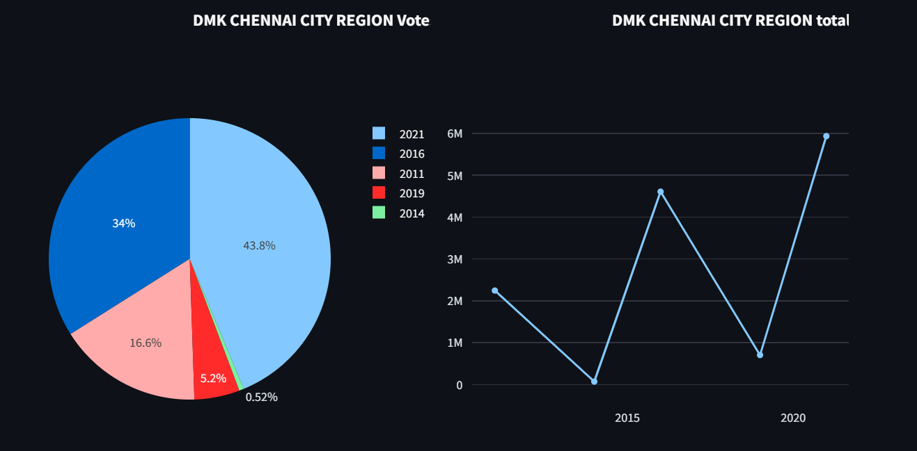

Explanation of Election App (Election App Link:https://pythonhrraulqvcel4auccwnzp8d.streamlit.app/)
LINEPLOT
Here, We can see the party wise line plot of Election party’s Total votes Comparison by selecting Party, year to year and Sub_rigions.
It will display total votes line and pie charts for each selected party.
CHEMICAL
NATURAL

Slide 27
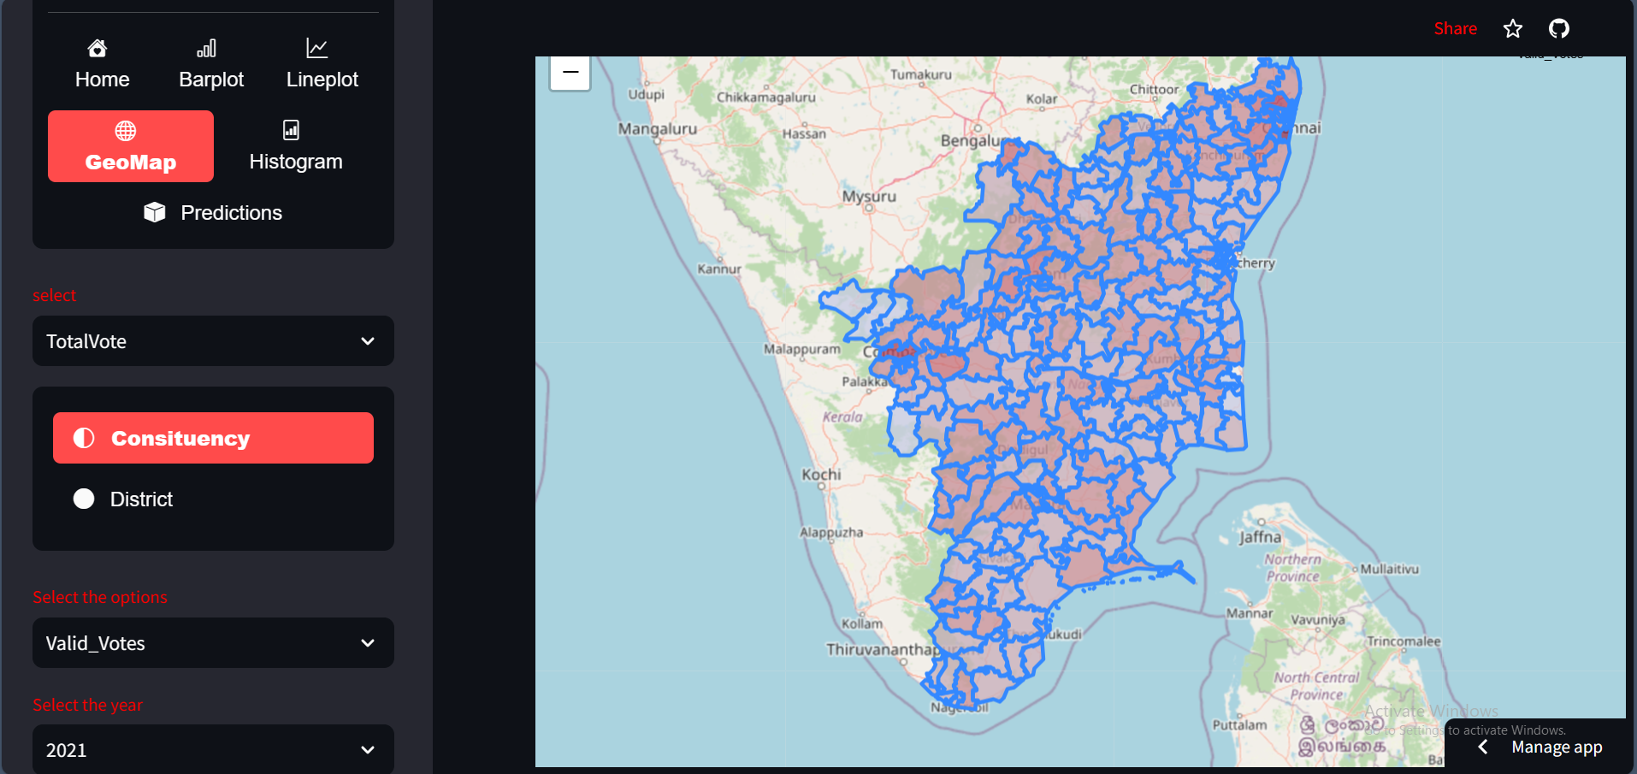
Explanation of Election App (Election App Link:https://pythonhrraulqvcel4auccwnzp8d.streamlit.app/)
GEOPLOT
Here visualized the Total valid vote Geo plot by selecting the all constituency and year wise.
Note: If we move cursor top of the Map, we can see the selected total Valid votes and Constituency name.
CHEMICAL
NATURAL

Slide 28
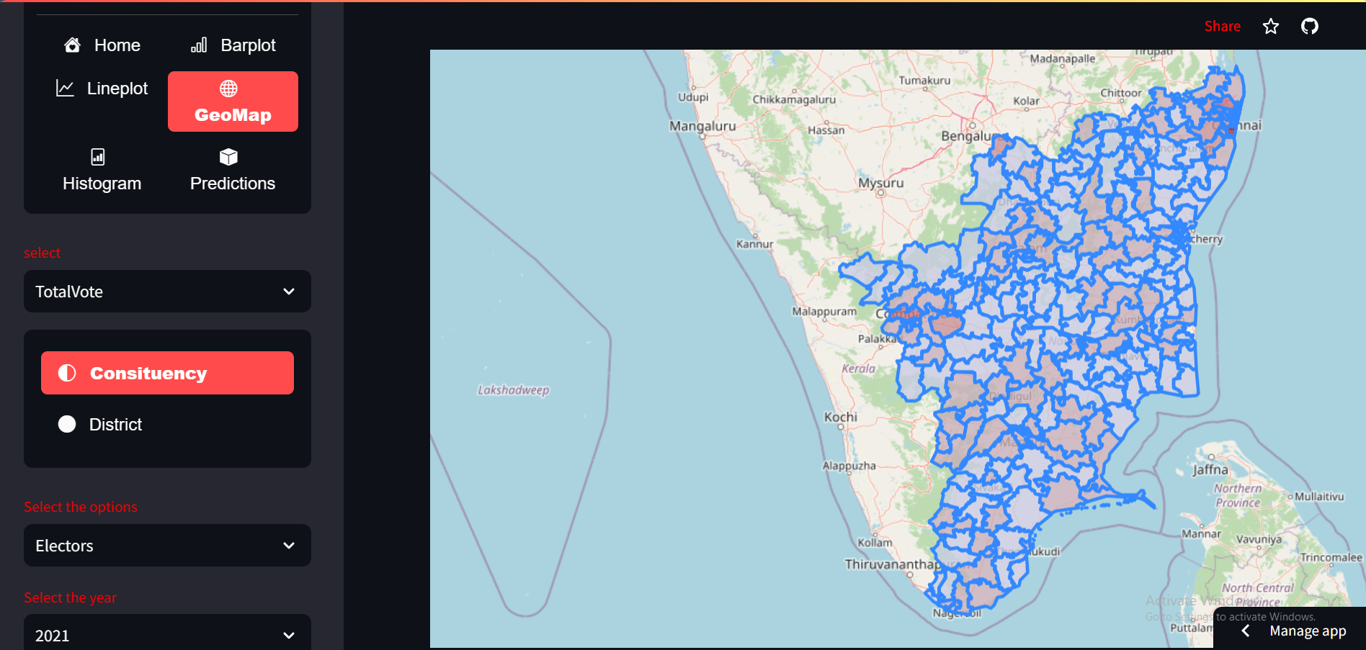
Explanation of Election App (Election App Link:https://pythonhrraulqvcel4auccwnzp8d.streamlit.app/)
GEOPLOT
Here visualized the Total Electors(Voters) Geo plot by selecting the all constituency and year wise
Note: If we move cursor top of the Map, we can see the selected total Electors and Constituency name.
CHEMICAL
NATURAL

Slide 29
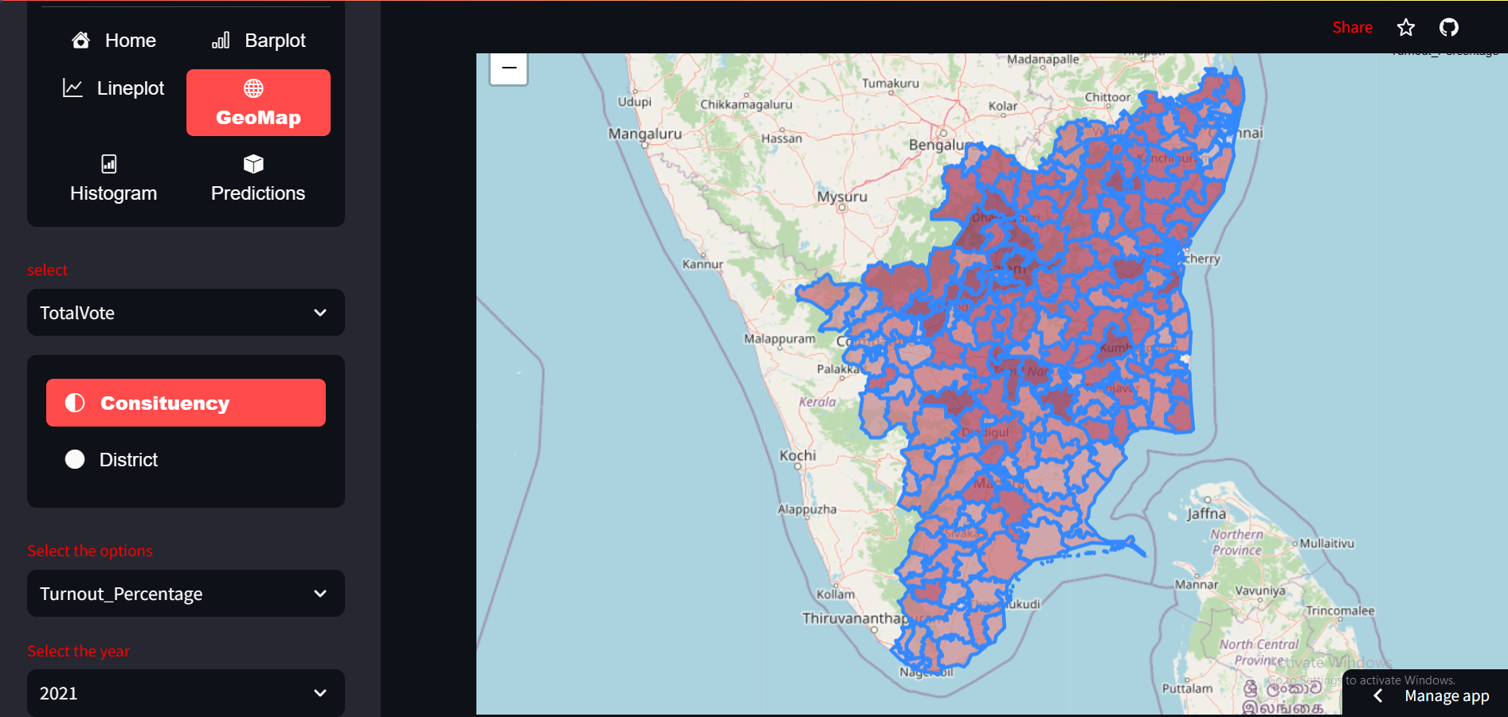
Explanation of Election App (Election App Link:https://pythonhrraulqvcel4auccwnzp8d.streamlit.app/)
GEOPLOT
Here visualized the Total Turnout vote percentage Geo plot by selecting the all constituency and year wise.
Note: If we move cursor top of the Map, we can see the selected total Turnout vote percentage and Constituency name.
CHEMICAL
NATURAL

Slide 30
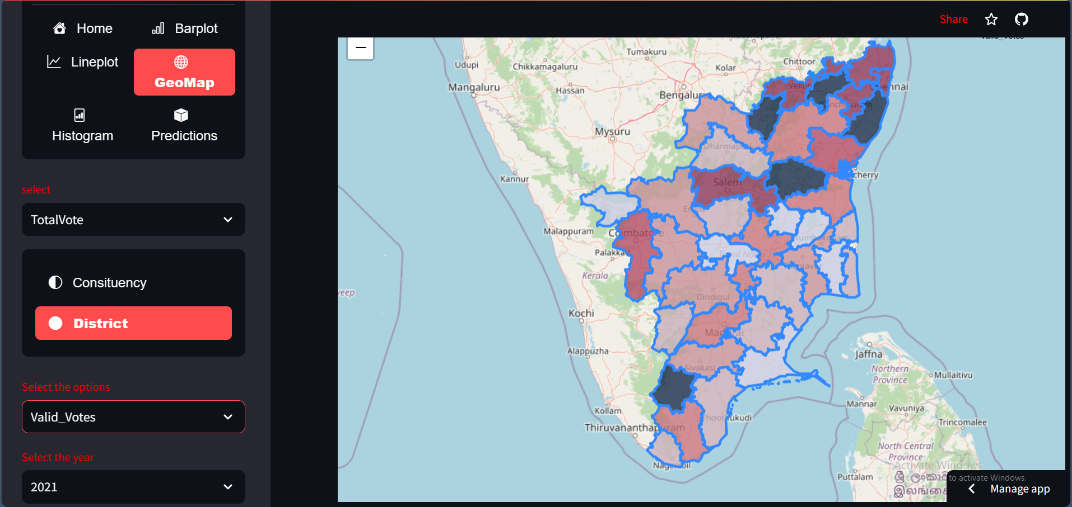
Explanation of Election App (Election App Link:https://pythonhrraulqvcel4auccwnzp8d.streamlit.app/)
GEOPLOT
Here visualized the Total valid vote Geo plot District wise by selected year.
Note: If we move cursor top of the Map, we can see the selected total Valid votes and District name.
CHEMICAL
NATURAL

Slide 31
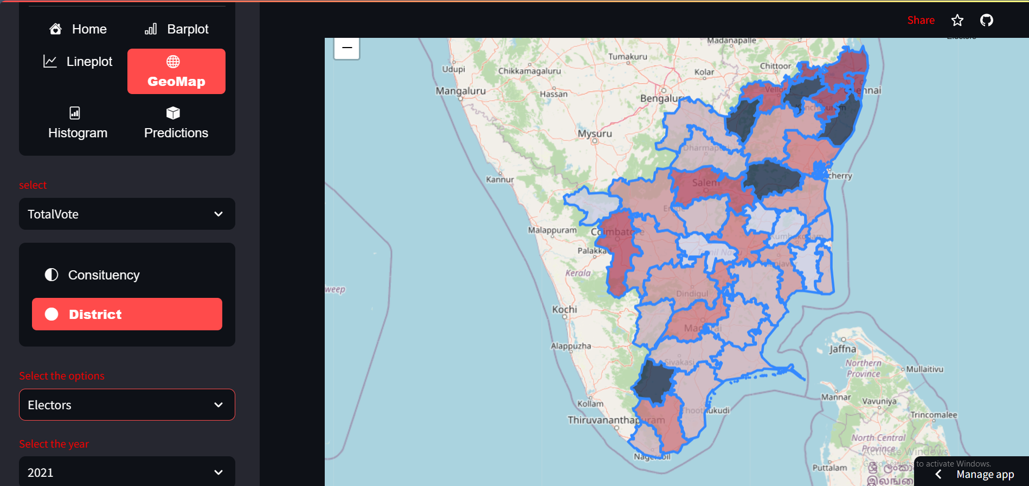
Explanation of Election App (Election App Link:https://pythonhrraulqvcel4auccwnzp8d.streamlit.app/)
GEOPLOT
Here visualized the Total electors(voters) Geo plot District wise by selected year.
Note: If we move cursor top of the Map, we can see the selected total Electors and District name.
CHEMICAL
NATURAL

Slide 32
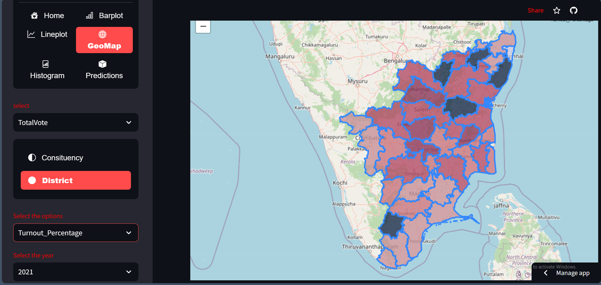
Explanation of Election App (Election App Link:https://pythonhrraulqvcel4auccwnzp8d.streamlit.app/)
GEOPLOT
Here visualized the Total Turnout vote percentage Geo plot District wise by selected year.
Note: If we move cursor top of the Map, we can see the selected total Turnout vote percentage and District name.
CHEMICAL
NATURAL

Slide 33
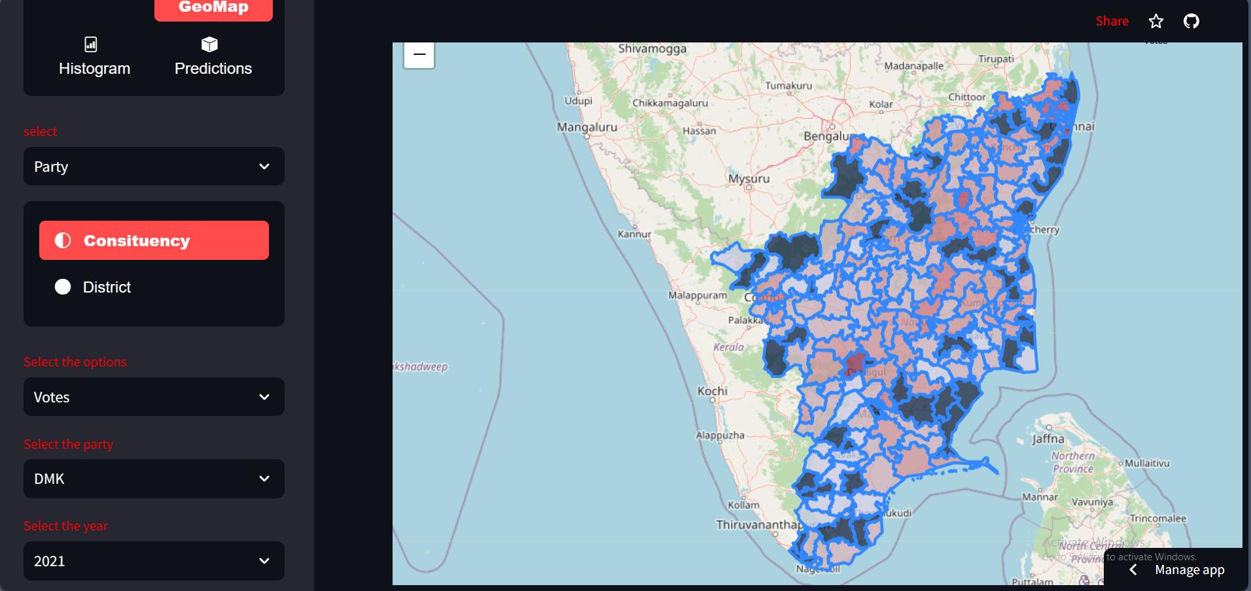
Explanation of Election App (Election App Link:https://pythonhrraulqvcel4auccwnzp8d.streamlit.app/)
GEOPLOT
Here visualized the DMK Total votes Geo plot Constituency wise by selected year.
Note: If we move cursor top of the Map, we can see the selected party votes and Constituency name.
CHEMICAL
NATURAL

Slide 34
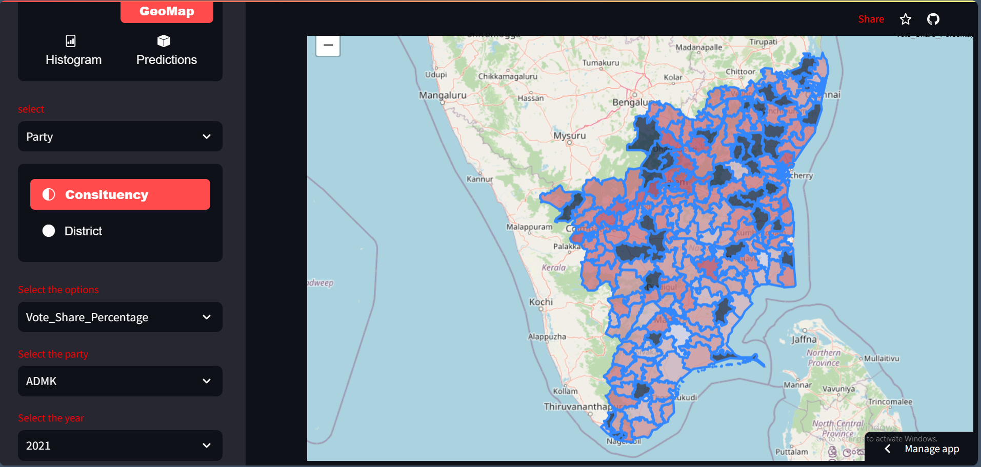
Explanation of Election App (Election App Link:https://pythonhrraulqvcel4auccwnzp8d.streamlit.app/)
GEOPLOT
Here visualized the ADMK Total vote share Percentage Geo plot Constituency wise by selected year.
Note: If we move cursor top of the Map, we can see the selected party votes share percentage and Constituency name.
CHEMICAL
NATURAL

Slide 35

Explanation of Election App (Election App Link:https://pythonhrraulqvcel4auccwnzp8d.streamlit.app/)
GEOPLOT
Here visualized the ADMK Margin vote Geo plot Constituency wise by selected year
Note: If we move cursor top of the Map, we can see the selected party Margin votes and Constituency name.
CHEMICAL
NATURAL

Slide 36
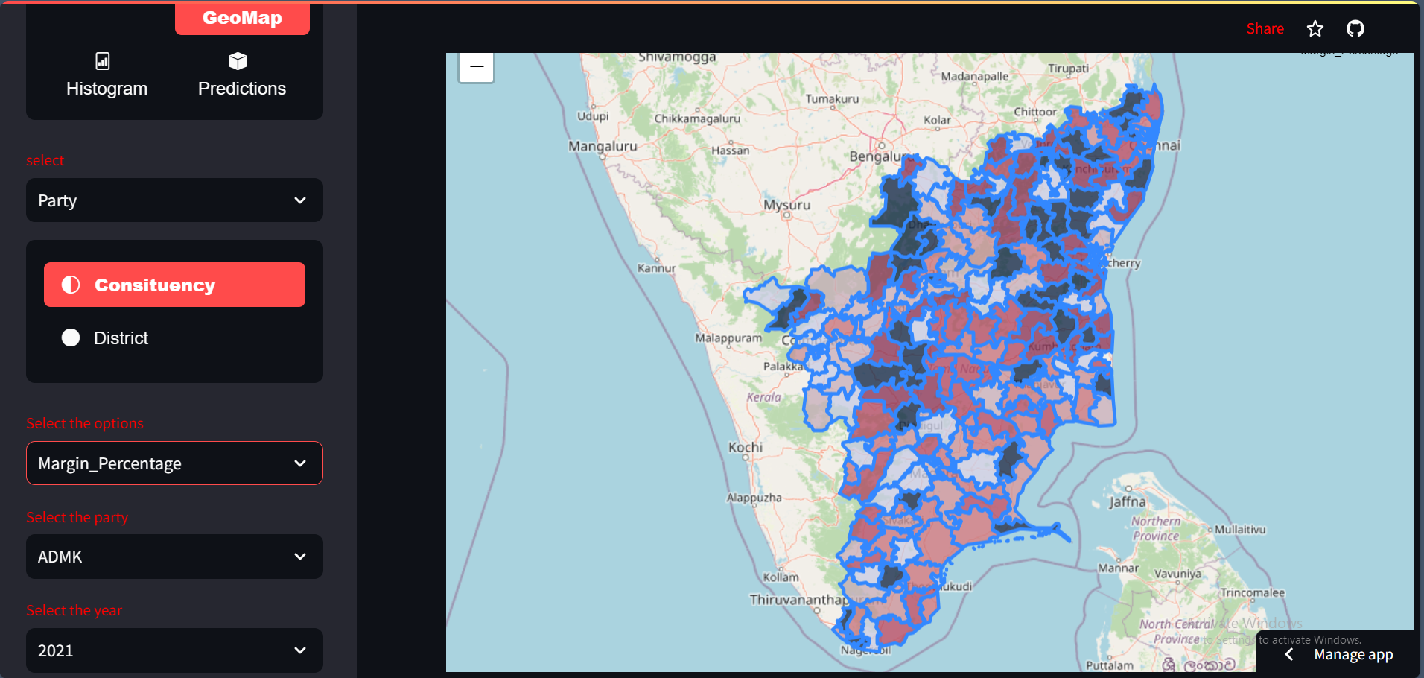
Explanation of Election App (Election App Link:https://pythonhrraulqvcel4auccwnzp8d.streamlit.app/)
GEOPLOT
Here visualized the ADMK Margin vote Percentage Geo plot Constituency wise by selected year.
Note: If we move cursor top of the Map, we can see the selected party Margin votes percentage and Constituency name.
CHEMICAL
NATURAL

Slide 37
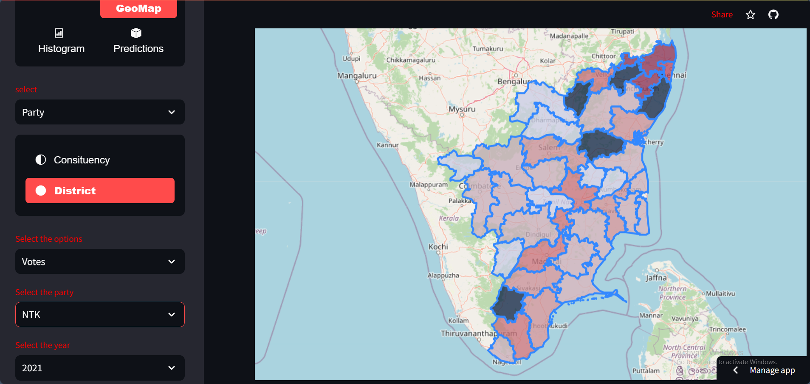
Explanation of Election App (Election App Link:https://pythonhrraulqvcel4auccwnzp8d.streamlit.app/)
GEOPLOT
Here visualized the NTK vote Geo plot District wise by selected year
Note: If we move cursor top of the Map, we can see the selected party votes and District name
CHEMICAL
NATURAL

Slide 38
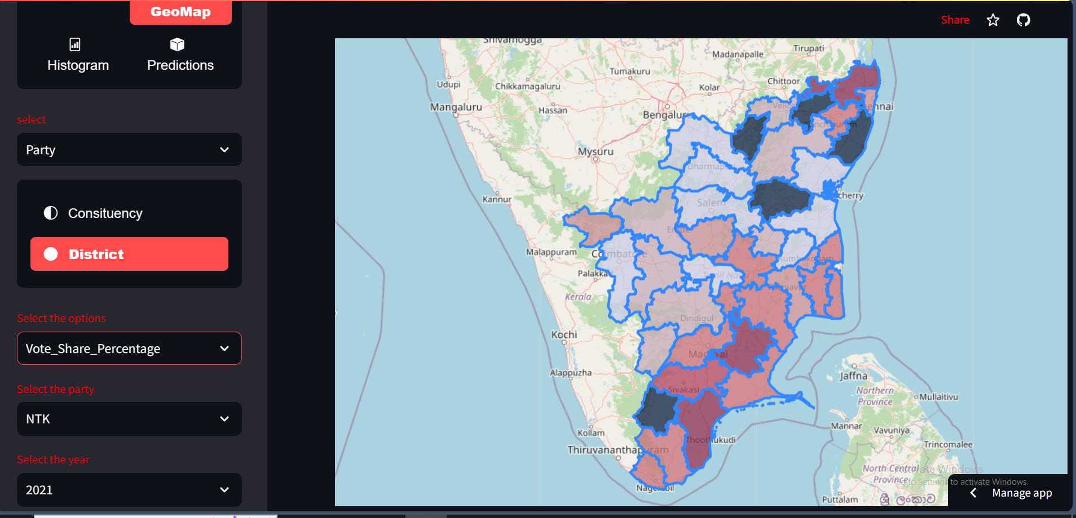
Explanation of Election App (Election App Link:https://pythonhrraulqvcel4auccwnzp8d.streamlit.app/)
GEOPLOT
Here visualized the NTK vote share percentage Geo plot District wise by selected year
Note: If we move cursor top of the Map, we can see the selected party vote share percentage and District name
CHEMICAL
NATURAL

Slide 39
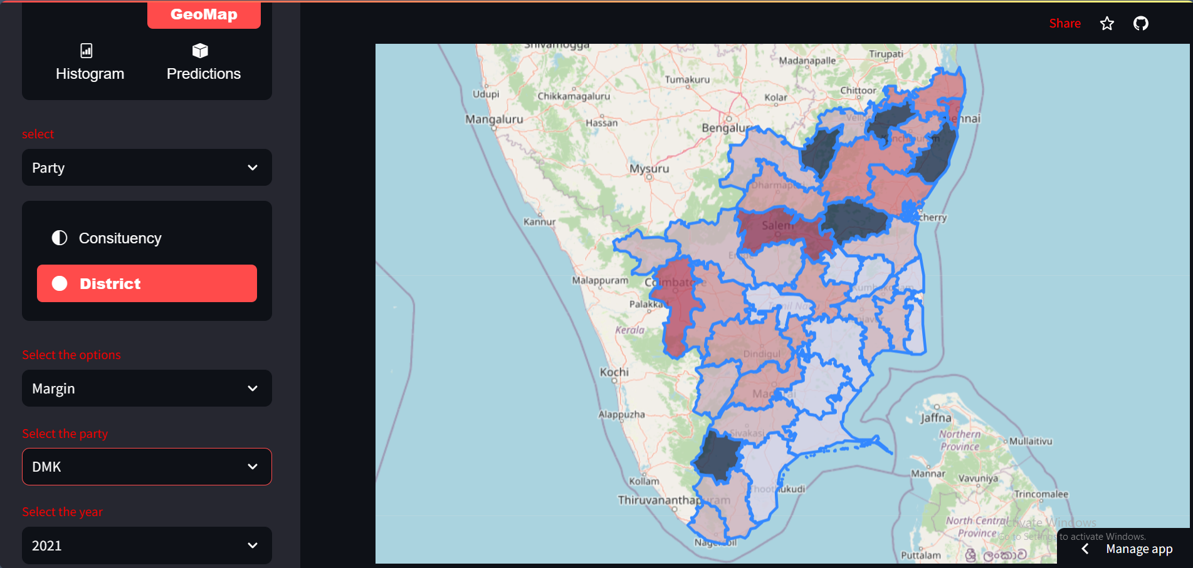
Explanation of Election App (Election App Link:https://pythonhrraulqvcel4auccwnzp8d.streamlit.app/)
GEOPLOT
Here visualized the DMK Margin vote Geo plot District wise by selected year
Note: If we move cursor top of the Map, we can see the selected party Margin votes and District name
CHEMICAL
NATURAL

Slide 40
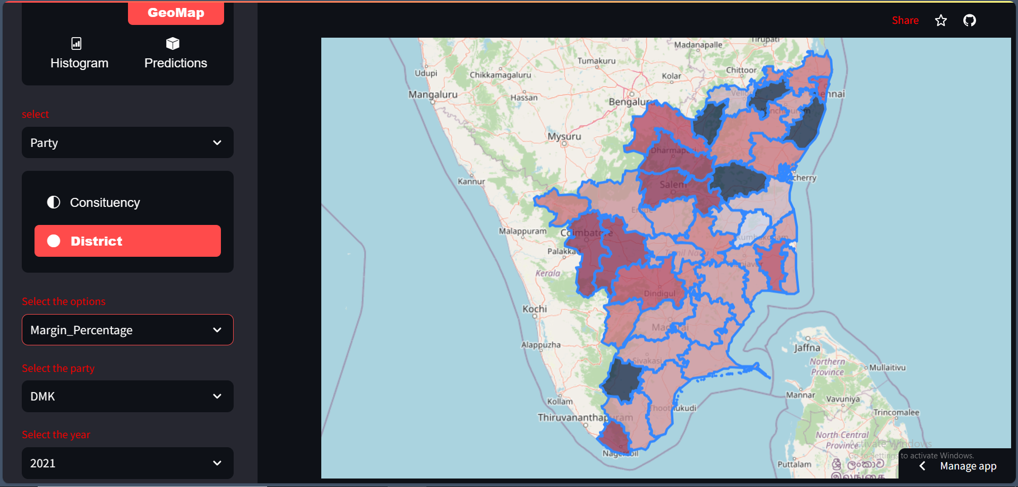
Explanation of Election App (Election App Link:https://pythonhrraulqvcel4auccwnzp8d.streamlit.app/)
GEOPLOT
Here visualized the DMK Margin vote percentage Geo plot District wise by selected year
Note: If we move cursor top of the Map we can see the selected party Margin votes Percentage and District name
CHEMICAL
NATURAL

Slide 41
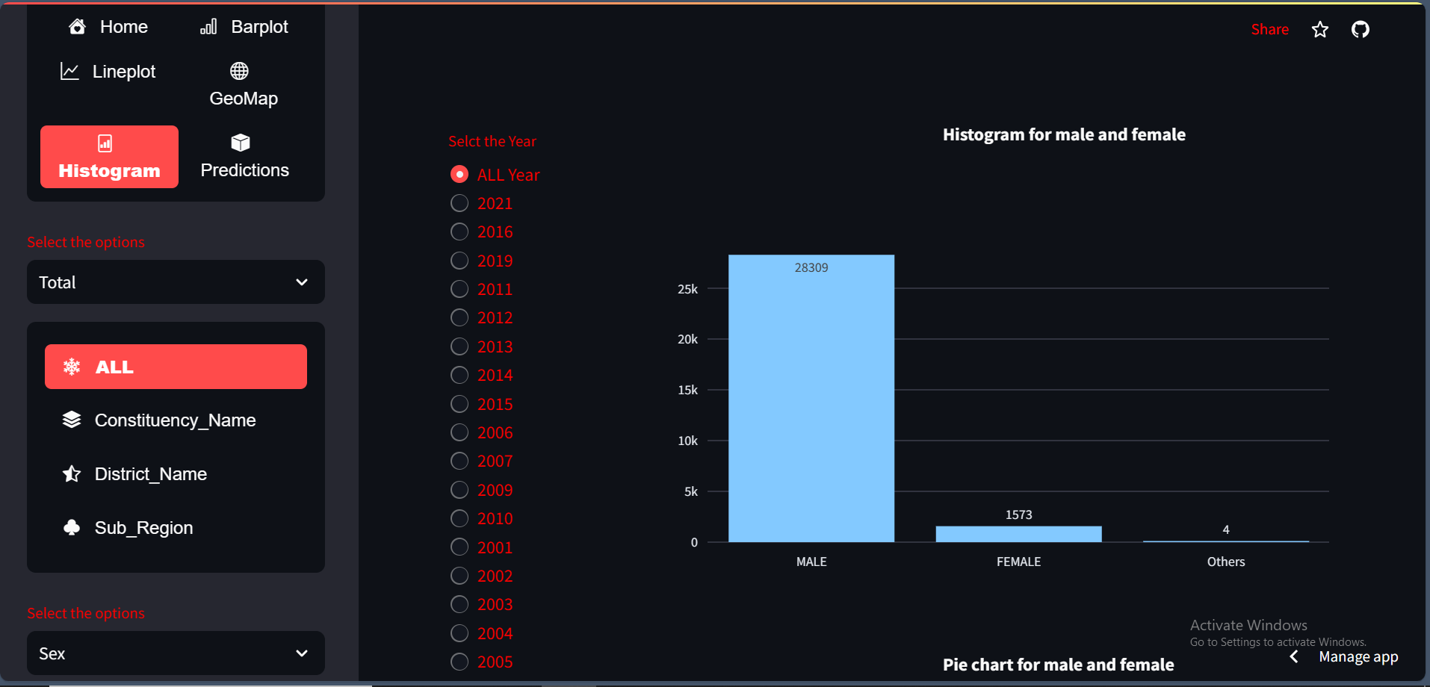

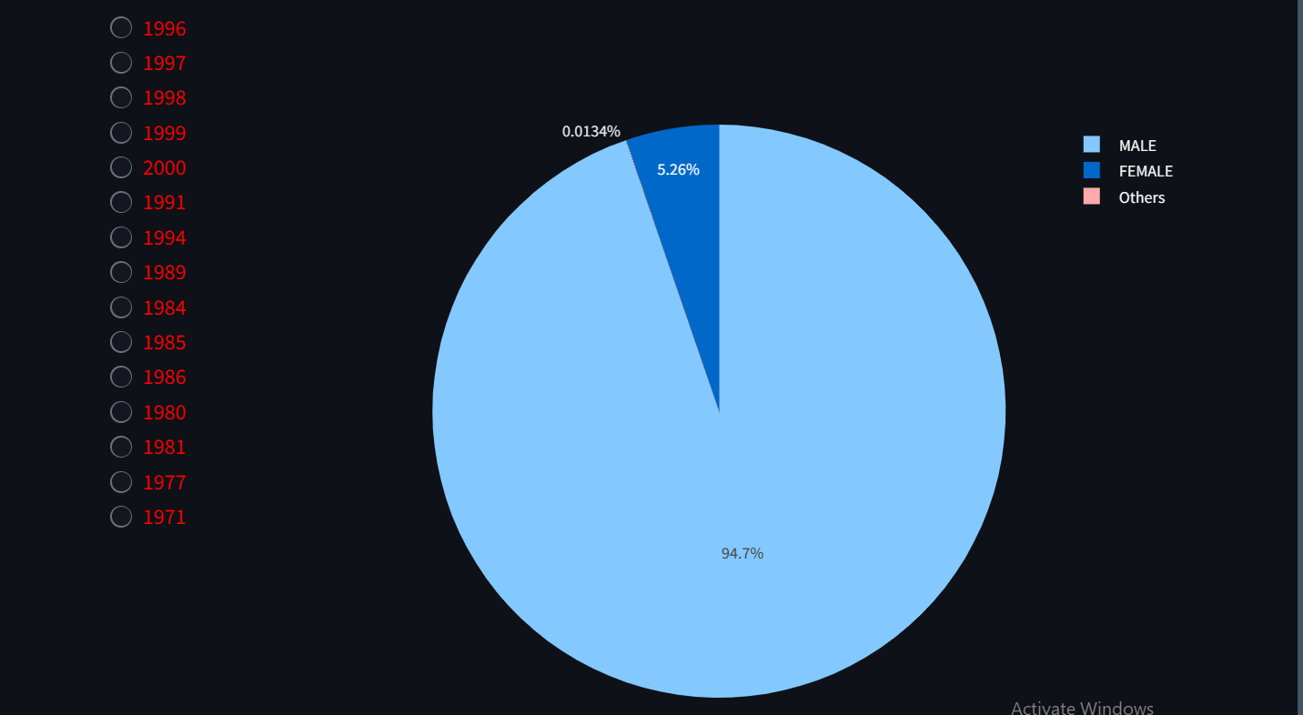
Explanation of Election App (Election App Link:https://pythonhrraulqvcel4auccwnzp8d.streamlit.app/)
GEOPLOT
Here visualized the All(full Tamil Nadu) candidate Gender histogram and pie chart for selected year.
CHEMICAL
NATURAL

Slide 42
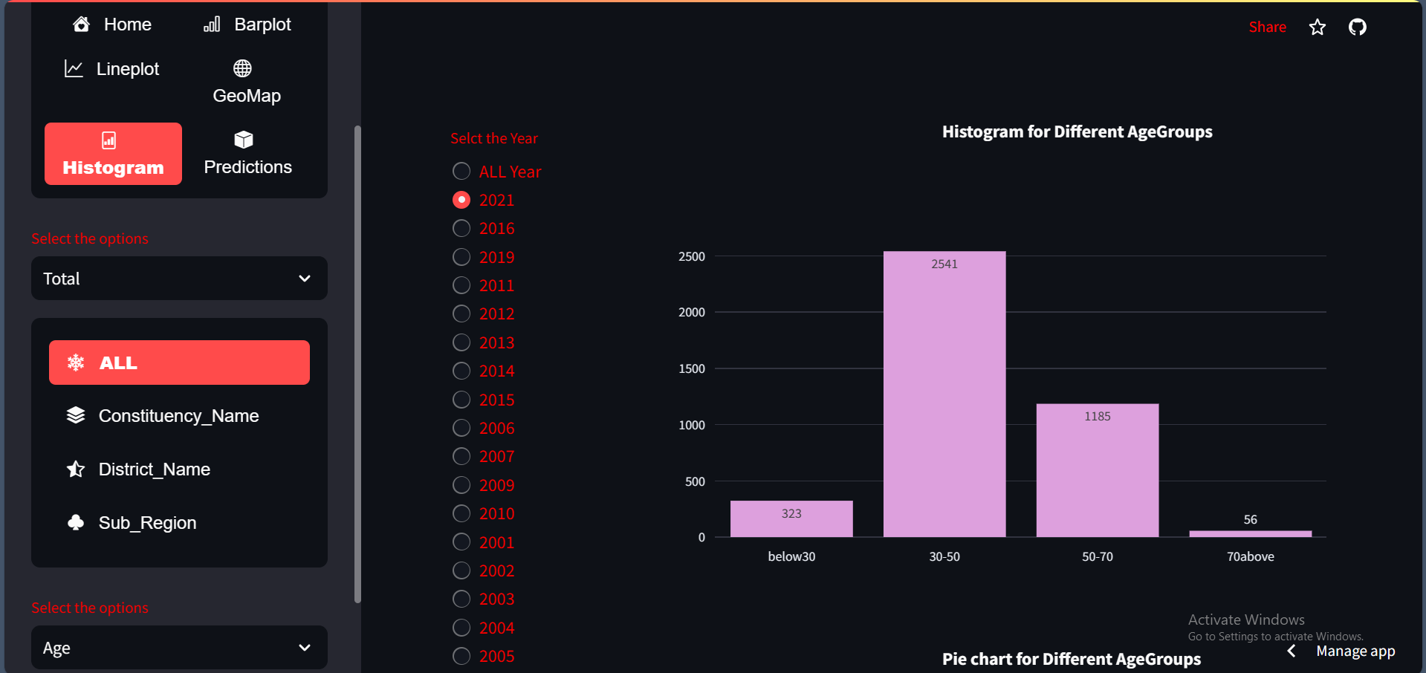
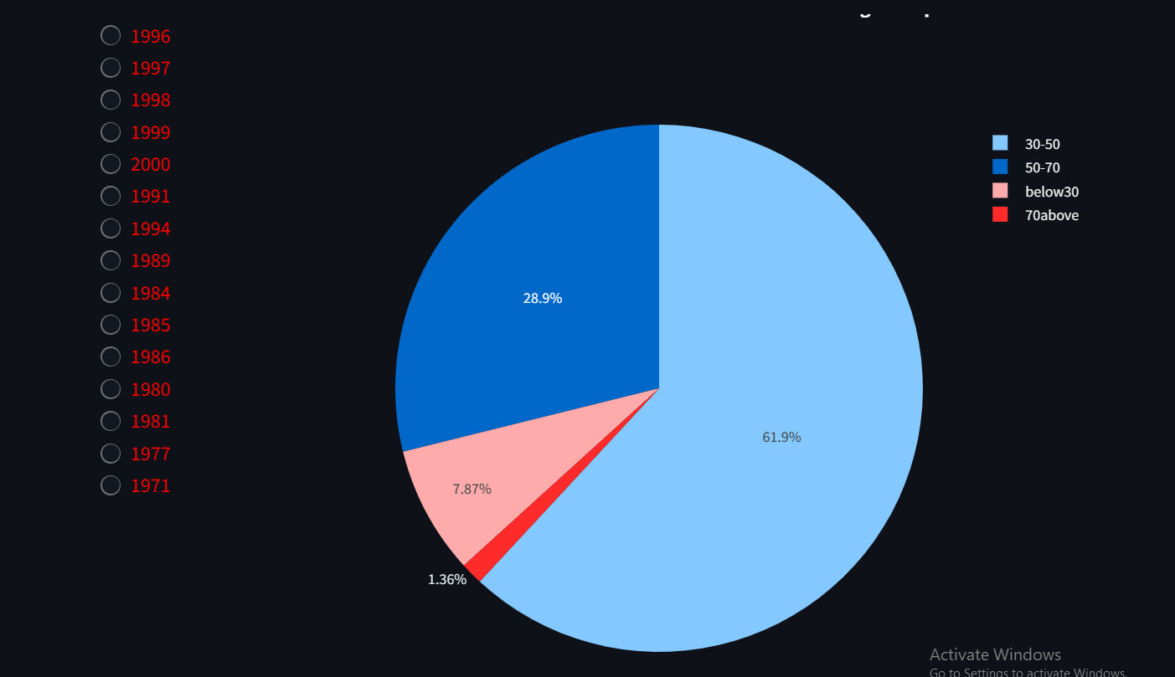
Explanation of Election App (Election App Link:https://pythonhrraulqvcel4auccwnzp8d.streamlit.app/)
GEOPLOT
Here visualized the All(full Tamil Nadu) candidate Age Group histogram and pie chart for selected year.
CHEMICAL
NATURAL

Slide 43


Explanation of Election App (Election App Link:https://pythonhrraulqvcel4auccwnzp8d.streamlit.app/)
GEOPLOT
Here visualized the All(full Tamil Nadu) Constituency type histogram and pie chart for selected year.
CHEMICAL
NATURAL

Slide 44


Explanation of Election App (Election App Link:https://pythonhrraulqvcel4auccwnzp8d.streamlit.app/)
GEOPLOT
Here visualized the All(full Tamil Nadu) Deposit Lost histogram and pie chart for selected year.
CHEMICAL
NATURAL

Slide 45


Explanation of Election App (Election App Link:https://pythonhrraulqvcel4auccwnzp8d.streamlit.app/)
GEOPLOT
Here visualized the selected Constituency Candidate Gender histogram and pie chart for selected year.
CHEMICAL
NATURAL

Slide 46


Explanation of Election App (Election App Link:https://pythonhrraulqvcel4auccwnzp8d.streamlit.app/)
GEOPLOT
Here visualized the selected Constituency Candidate Age Group histogram and pie chart for selected year.
CHEMICAL
NATURAL

Slide 47


Explanation of Election App (Election App Link:https://pythonhrraulqvcel4auccwnzp8d.streamlit.app/)
GEOPLOT
Here visualized the selected Constituency Consitituency_Type histogram and pie chart for selected year.
CHEMICAL
NATURAL

Slide 48


Explanation of Election App (Election App Link:https://pythonhrraulqvcel4auccwnzp8d.streamlit.app/)
GEOPLOT
Here visualized the selected Constituency Deposit Lost histogram and pie chart for selected year.
CHEMICAL
NATURAL

Slide 49


Explanation of Election App (Election App Link:https://pythonhrraulqvcel4auccwnzp8d.streamlit.app/)
GEOPLOT
Here visualized the selected District Candidate Gender histogram and pie chart for selected year.
CHEMICAL
NATURAL

Slide 50


Explanation of Election App (Election App Link:https://pythonhrraulqvcel4auccwnzp8d.streamlit.app/)
GEOPLOT
Here visualized the selected District Candidate Age Group histogram and pie chart for selected year.
CHEMICAL
NATURAL

Slide 51


Explanation of Election App (Election App Link:https://pythonhrraulqvcel4auccwnzp8d.streamlit.app/)
GEOPLOT
Here visualized the selected District Constituency Type histogram and pie chart for selected year.
CHEMICAL
NATURAL

Slide 52


Explanation of Election App (Election App Link:https://pythonhrraulqvcel4auccwnzp8d.streamlit.app/)
GEOPLOT
Here visualized the selected District Deposit Lost histogram and pie chart for selected year.
CHEMICAL
NATURAL

Slide 53


Explanation of Election App (Election App Link:https://pythonhrraulqvcel4auccwnzp8d.streamlit.app/)
GEOPLOT
Here visualized the selected Sub Region candidate Gender histogram and pie chart for selected year.
CHEMICAL
NATURAL

Slide 54


Explanation of Election App (Election App Link:https://pythonhrraulqvcel4auccwnzp8d.streamlit.app/)
GEOPLOT
Here visualized the selected Sub Region candidate Age Group histogram and pie chart for selected year.
CHEMICAL
NATURAL

Slide 55


Explanation of Election App (Election App Link:https://pythonhrraulqvcel4auccwnzp8d.streamlit.app/)
GEOPLOT
Here visualized the selected Sub Region Constituency Type histogram and pie chart for selected year.
CHEMICAL
NATURAL

Slide 56


Explanation of Election App (Election App Link:https://pythonhrraulqvcel4auccwnzp8d.streamlit.app/)
GEOPLOT
Here visualized the selected Sub Region Deposit Lost histogram and pie chart for selected year.
CHEMICAL
NATURAL

Slide 57

Explanation of Election App (Election App Link:https://pythonhrraulqvcel4auccwnzp8d.streamlit.app/)
HISTOGRAM
Here visualized the All(full Tamil Nadu) DMDK[selected Party] Candidate Gender histogram and pie chart for selected year.
CHEMICAL
NATURAL

Slide 58

Explanation of Election App (Election App Link:https://pythonhrraulqvcel4auccwnzp8d.streamlit.app/)
HISTOGRAM
Here visualized the All(full Tamil Nadu) DMK[selected party] Candidate Age Group histogram and pie chart for selected year.
CHEMICAL
NATURAL

Slide 59

Explanation of Election App (Election App Link:https://pythonhrraulqvcel4auccwnzp8d.streamlit.app/)
HISTOGRAM
Here visualized the All(full Tamil Nadu) DMK[selected party] Constituency Type histogram and pie chart for selected year.
CHEMICAL
NATURAL

Slide 60

Explanation of Election App (Election App Link:https://pythonhrraulqvcel4auccwnzp8d.streamlit.app/)
HISTOGRAM
Here visualized the All(full Tamil Nadu) DMK[selected party] Deposit Lost histogram and pie chart for selected year.
CHEMICAL
NATURAL

Slide 61


Explanation of Election App (Election App Link:https://pythonhrraulqvcel4auccwnzp8d.streamlit.app/)
HISTOGRAM
Here visualized the NTK[selected party] Candidate Gender histogram and pie chart for selected year and constituency.
CHEMICAL
NATURAL

Slide 62


Explanation of Election App (Election App Link:https://pythonhrraulqvcel4auccwnzp8d.streamlit.app/)
HISTOGRAM
Here visualized the NTK[selected party] Candidate Age Group histogram and pie chart for selected year and constituency.
CHEMICAL
NATURAL

Slide 63


Explanation of Election App (Election App Link:https://pythonhrraulqvcel4auccwnzp8d.streamlit.app/)
HISTOGRAM
Here visualized the NTK[selected party] Constituency Type histogram and pie chart for selected year and constituency.
CHEMICAL
NATURAL

Slide 64

Explanation of Election App (Election App Link:https://pythonhrraulqvcel4auccwnzp8d.streamlit.app/)
HISTOGRAM
Here visualized the DMK[selected party] Deposit Lost histogram and pie chart for selected year and constituency.
CHEMICAL
NATURAL

Slide 65


Explanation of Election App (Election App Link:https://pythonhrraulqvcel4auccwnzp8d.streamlit.app/)
HISTOGRAM
Here visualized the DMK[selected party] Candidate Gender histogram and pie chart for selected year and District.
CHEMICAL
NATURAL

Slide 66


Explanation of Election App (Election App Link:https://pythonhrraulqvcel4auccwnzp8d.streamlit.app/)
HISTOGRAM
Here visualized the DMK[selected party] Candidate Age Group histogram and pie chart for selected year and District name.
CHEMICAL
NATURAL

Slide 67


Explanation of Election App (Election App Link:https://pythonhrraulqvcel4auccwnzp8d.streamlit.app/)
HISTOGRAM
Here visualized the DMK[selected party] Constituency Type histogram and pie chart for selected year and District name.
CHEMICAL
NATURAL

Slide 68


Explanation of Election App (Election App Link:https://pythonhrraulqvcel4auccwnzp8d.streamlit.app/)
HISTOGRAM
Here visualized the DMK[selected party] Deposit Lost histogram and pie chart for selected year and District name.
CHEMICAL
NATURAL

Slide 69


Explanation of Election App (Election App Link:https://pythonhrraulqvcel4auccwnzp8d.streamlit.app/)
HISTOGRAM
Here visualized the DMK[selected party] Candidate Gender histogram and pie chart for selected year and Subregion name.
CHEMICAL
NATURAL

Slide 70


Explanation of Election App (Election App Link:https://pythonhrraulqvcel4auccwnzp8d.streamlit.app/)
HISTOGRAM
Here visualized the ADMK[selected party] Candidate Age Group histogram and pie chart for selected year and Subregion name.
CHEMICAL
NATURAL

Slide 71


Explanation of Election App (Election App Link:https://pythonhrraulqvcel4auccwnzp8d.streamlit.app/)
HISTOGRAM
Here visualized the ADMK[selected party] Constituency Type histogram and pie chart for selected year and Subregion name.
CHEMICAL
NATURAL

Slide 72


Explanation of Election App (Election App Link:https://pythonhrraulqvcel4auccwnzp8d.streamlit.app/)
HISTOGRAM
Here visualized the ADMK[selected party] Deposit Lost histogram and pie chart for selected year and Subregion name.
CHEMICAL
NATURAL

Slide 73

Explanation of Election App (Election App Link:https://pythonhrraulqvcel4auccwnzp8d.streamlit.app/)
Predictions
Here we Predicted Total Valid votes,Turnout_vote_percentage and electors for selected future year and selected constituency’s
Note: we have used LinearRegression()machine learning algorithm for here.
CHEMICAL
NATURAL

Slide 74

Explanation of Election App (Election App Link:https://pythonhrraulqvcel4auccwnzp8d.streamlit.app/)
Predictions
Here we Predicted party wise votes for selected future year and selected constituency’s
Note: we have used LinearRegression( machine learning algorithm for here.
CHEMICAL
NATURAL

Slide 75

Explanation of Election App (Election App Link:https://pythonhrraulqvcel4auccwnzp8d.streamlit.app/)
Predictions
Here we Predicted party wise Gender for selected future year and selected constituency’s
Note: we have used RandomForestClassifier() machine learning algorithm for here.
CHEMICAL
NATURAL

Slide 76

Explanation of Election App (Election App Link:https://pythonhrraulqvcel4auccwnzp8d.streamlit.app/)
Predictions
Here we Predicted party wise position for selected future year and selected constituency’s
Note: we have used RandomForestClassifier() machine learning algorithm for here.
CHEMICAL
NATURAL

Slide 77

Explanation of Election App (Election App Link:https://pythonhrraulqvcel4auccwnzp8d.streamlit.app/)
Predictions
Here we Predicted Total Valid votes,Turnout_vote_percentage and electors for selected existing dataset year and selected constituency’s
Note: we have used RandomForestRegressor() machine learning algorithm for here.
CHEMICAL
NATURAL

Slide 78

Explanation of Election App (Election App Link:https://pythonhrraulqvcel4auccwnzp8d.streamlit.app/)
Predictions
Here we Predicted party wise votes for selected existing dataset year and selected constituency’s
Note: we have used RandomForestClassifier() machine learning algorithm for here.
CHEMICAL
NATURAL

Slide 79

Explanation of Election App (Election App Link:https://pythonhrraulqvcel4auccwnzp8d.streamlit.app/)
Predictions
Here we Predicted party wise Gender for selected existing dataset year and selected constituency’s
Note: we have used RandomForestClassifier() machine learning algorithm for here.
CHEMICAL
NATURAL

Slide 80

Explanation of Election App (Election App Link:https://pythonhrraulqvcel4auccwnzp8d.streamlit.app/)
Predictions
Here we Predicted party wise position for selected existing dataset year and selected constituency’s
Note: we have used DecisionTreeClassifier() machine learning algorithm for here.
CHEMICAL
NATURAL

Slide 81

Thank you
Karthik R
Email: karthikmca6622@gmail.com
Phone: 9944194787
Election App Link:https://pythonhrraulqvcel4auccwnzp8d.streamlit.app/)

